Slide 1
Climate Change
Enduring Understanding:
Chugach Regional Elders lifelong knowledge of environment and resources helps us understand the changes in climate

Slide 2
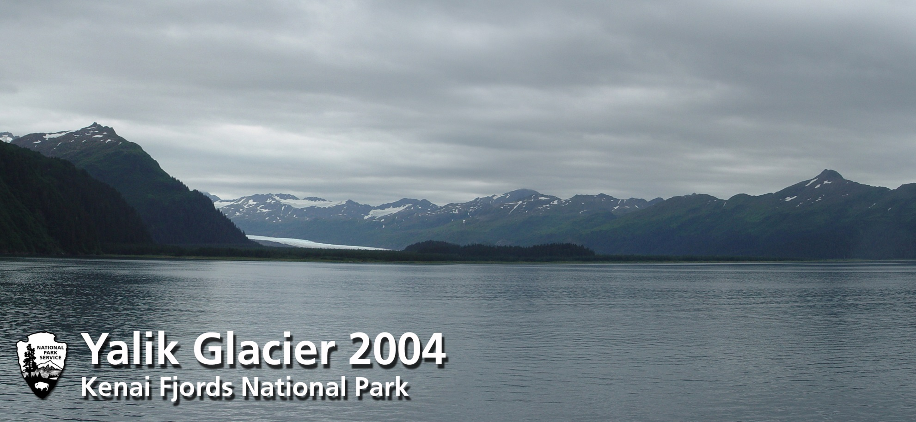
What we see now…

Slide 3
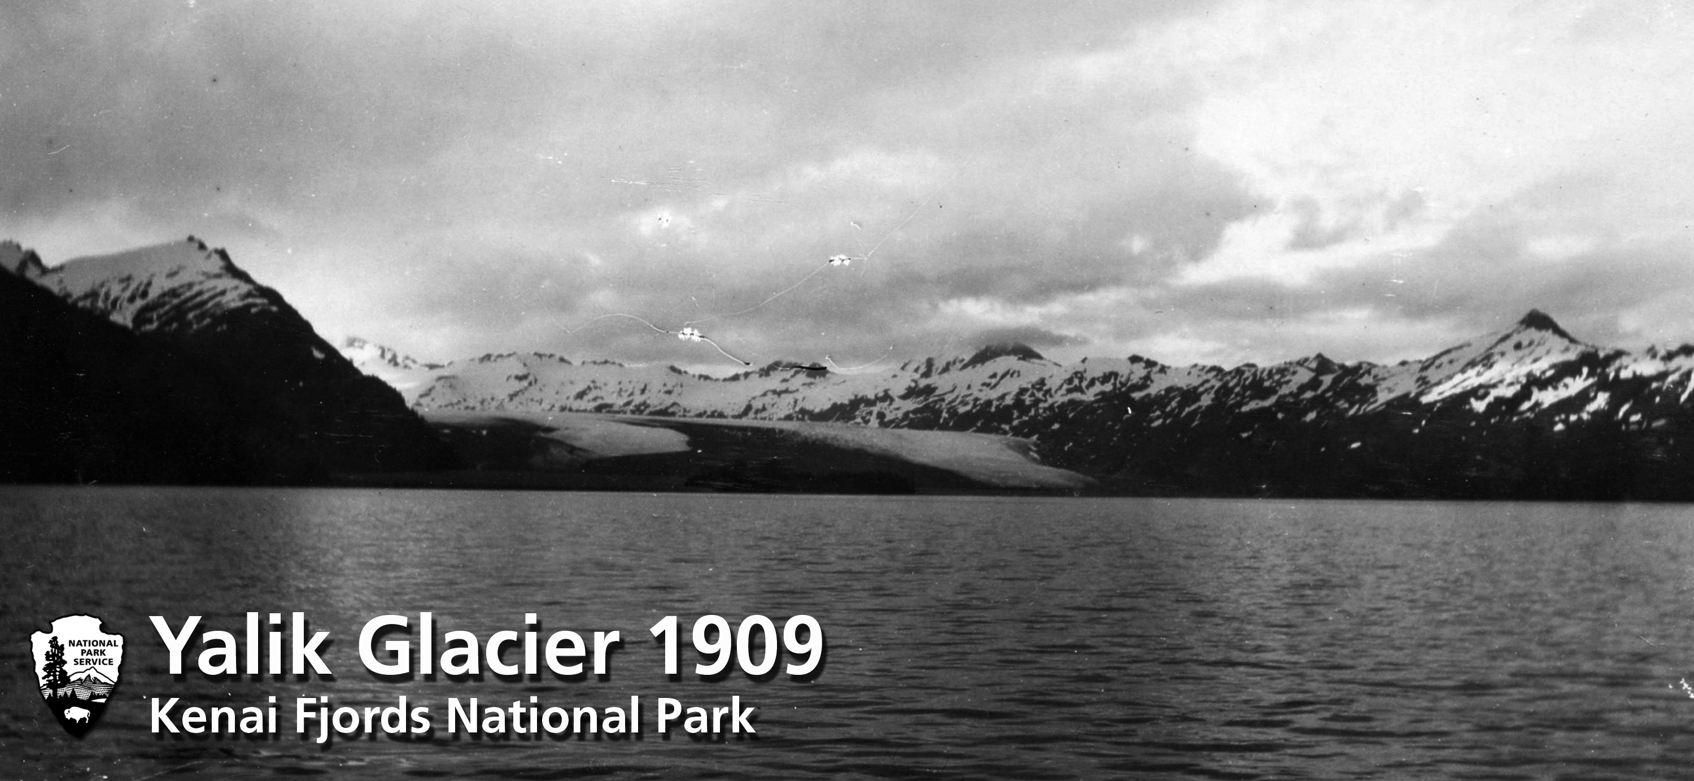
What they saw then…

Slide 4
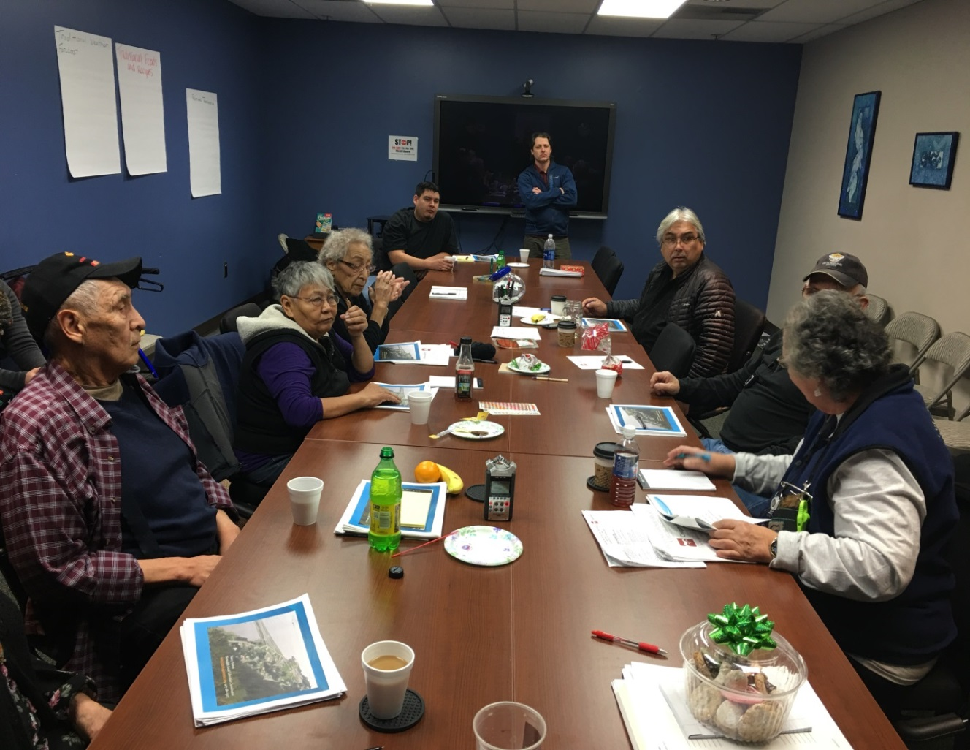
Essential Questions
What is climate?
How has the climate changed in the past?
How has climate effected the local environment resources?

Slide 5
Elders comments:
Pam Smith- “There is a new species of sea weed growing in the Eyak Lake, it was never there before and noticed it last year. Storms wash it up on the beaches. There are different bird species because it’s so warm. We have noticed a new seagull species.”
Mark King- “There was a Stellar Sea Eagle spotted in Cordova.”
Patrick Selanoff- The bears have been coming out of their dens early, some bears are still out in spring and winter.”
Robert Vlasoff- “There isn’t any ice flow from the rivers and you’re able to see sandbars and there are no more sea cucumbers.”

Slide 6

Nicka Tanape
“Our world never changes in the inside but outside changes, llaggpit ciimertuq.”

Slide 7
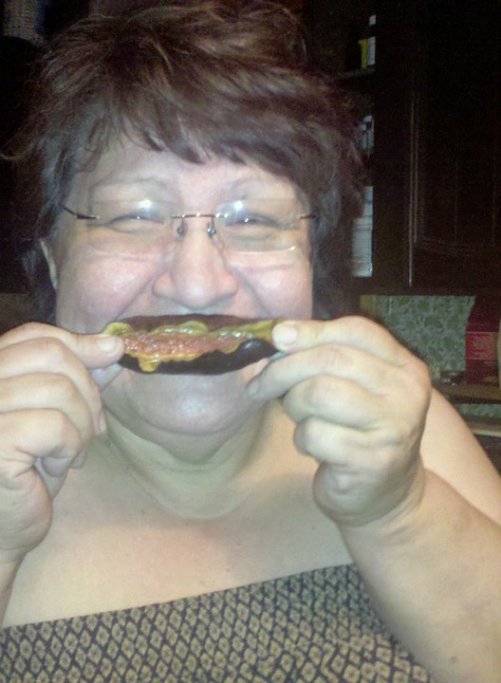
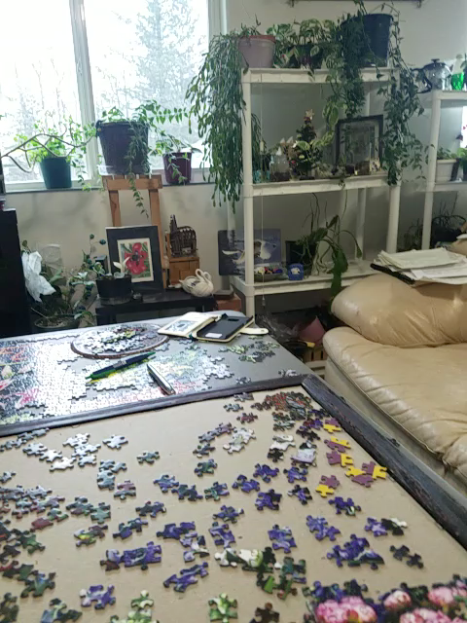
Lillian Elvsaas
“It is getting warmer, windier, no snow, rainier, it’s changing,” the Elders long time ago said it would be like this. Nupuat picurtuq nuna ciimertuq aqllat maqiluta.”

Slide 8
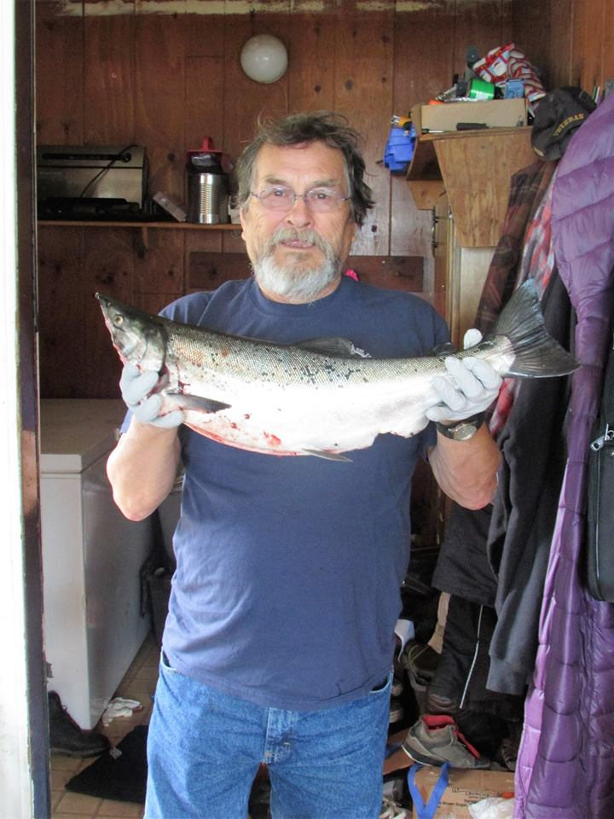
Ephim Moonin
“It’s changing outside, llaa ciimertuq.”

Slide 9
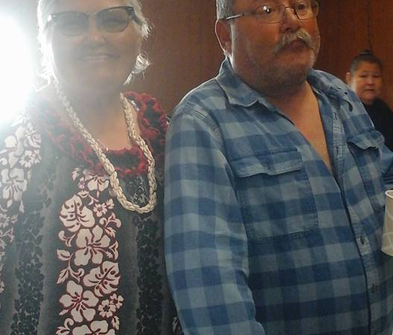
John Moonin
“There is a time of the year when these events take place, now it happens any time.
Wind is getting stronger, aqllat tukniugut, rain longer, gitit mulut, tides are getting more bigger, tungit angliut, no ice. cikuilluta,

Slide 10
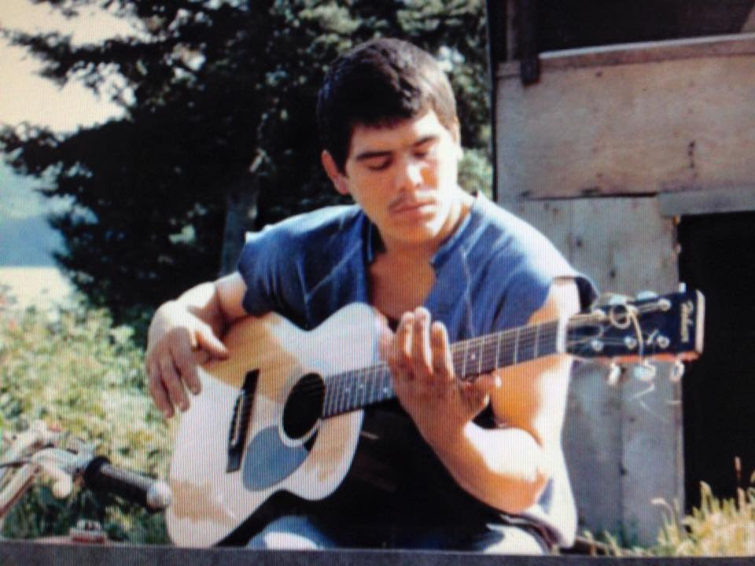
Charles Moonin
“Earth is changing, nuna ciimertuq

Slide 11
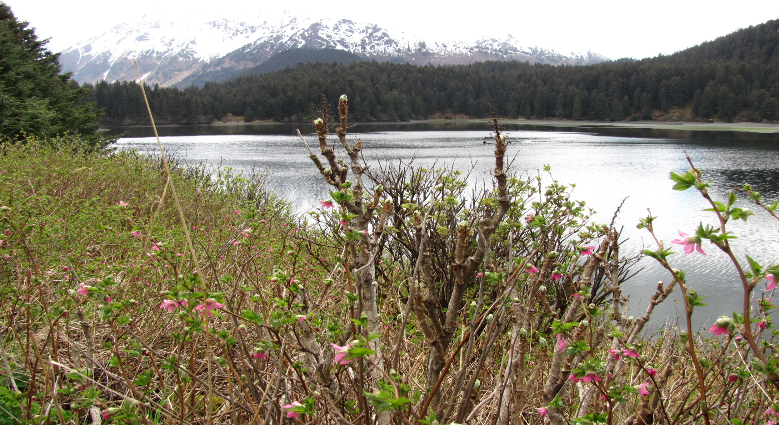
February 2017

Slide 12
Plants are mixed up
Last February, salmonberry bushes were blossoming along with the Devil Clubs
Green grass
Blossoms on berry bushes

Slide 13
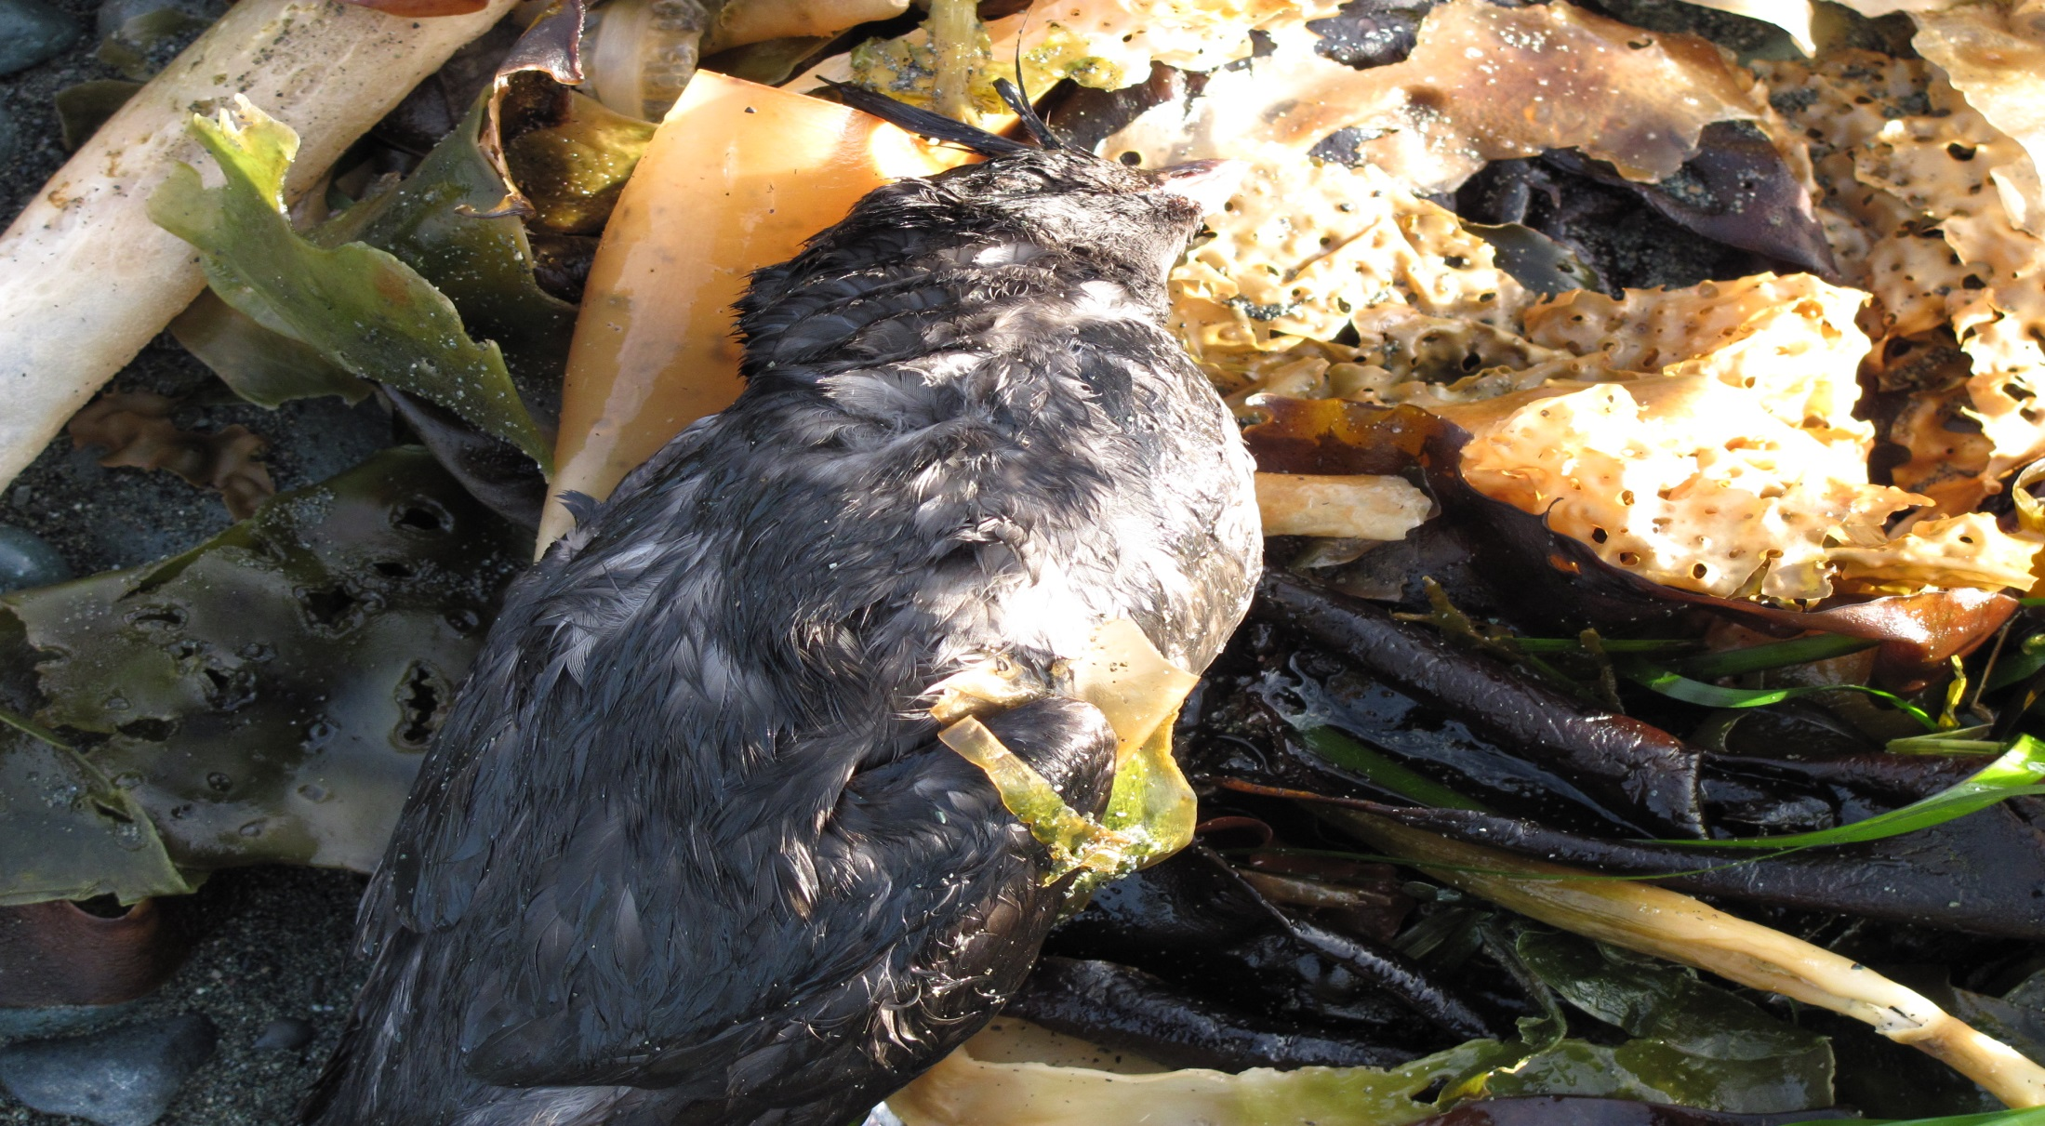
Ocean Waters are warming up, causing starvation

Slide 14
Bird die offs
Ancient Murrelet
Tufted Puffins
Horned Puffins
Murre-die off larger than the Exxon oil spill

Slide 15
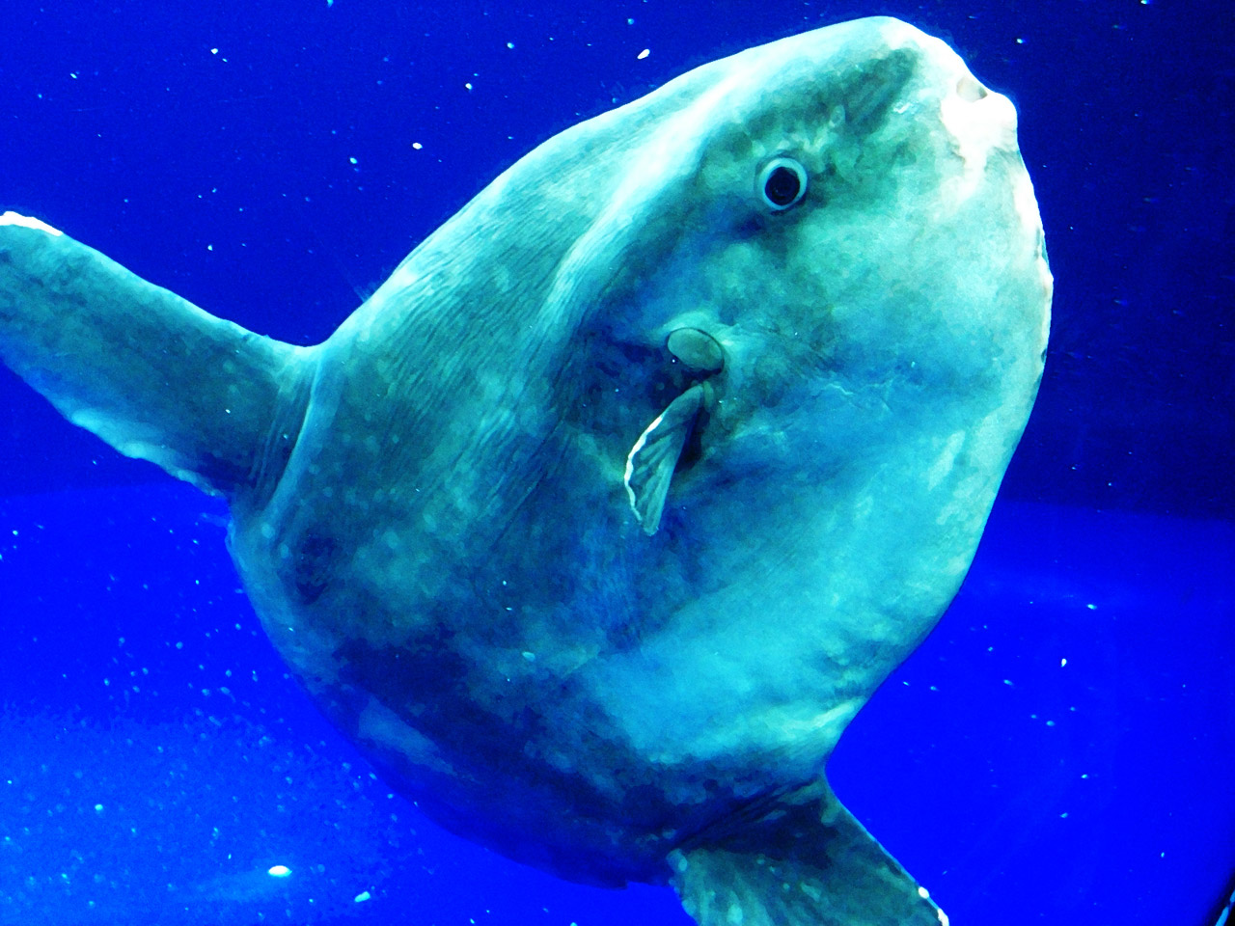

“There was a sighting of a sunfish in Hinchinbrook Pass, Sunfish are a tropical fish species.” Mark King, Cordova

Slide 16
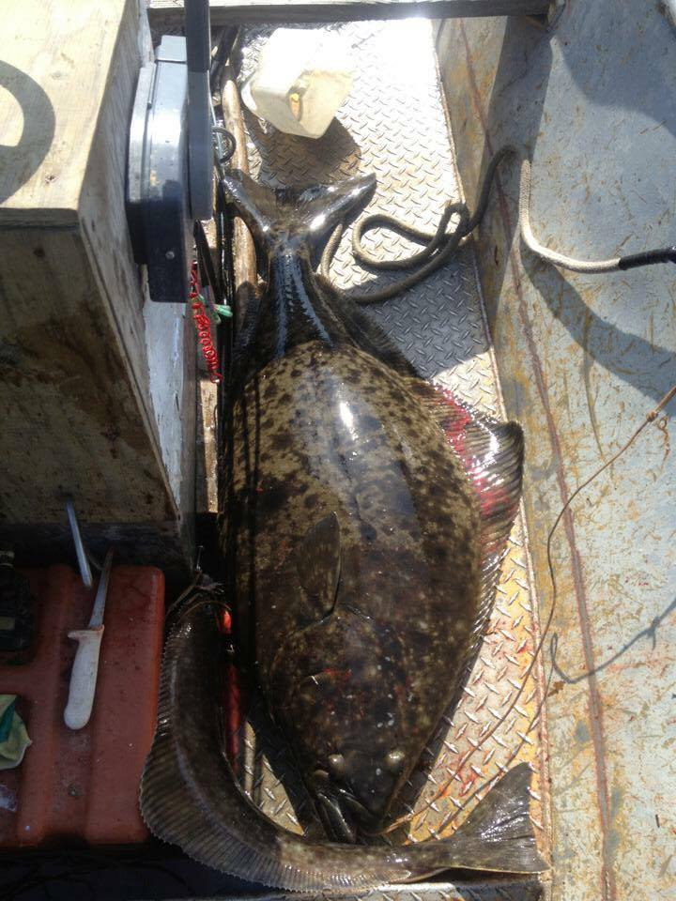
Halibut
Mark King:
“Halibut while longlining and delivering the halibut to the processor, some of the halibut were marked down as “Chalky Halibut” they were told that these halibut are different because of two things, one is that the halibut are fighting too much while they are hooked to the ground line, two is that the halibut could have parasites.”

Slide 17
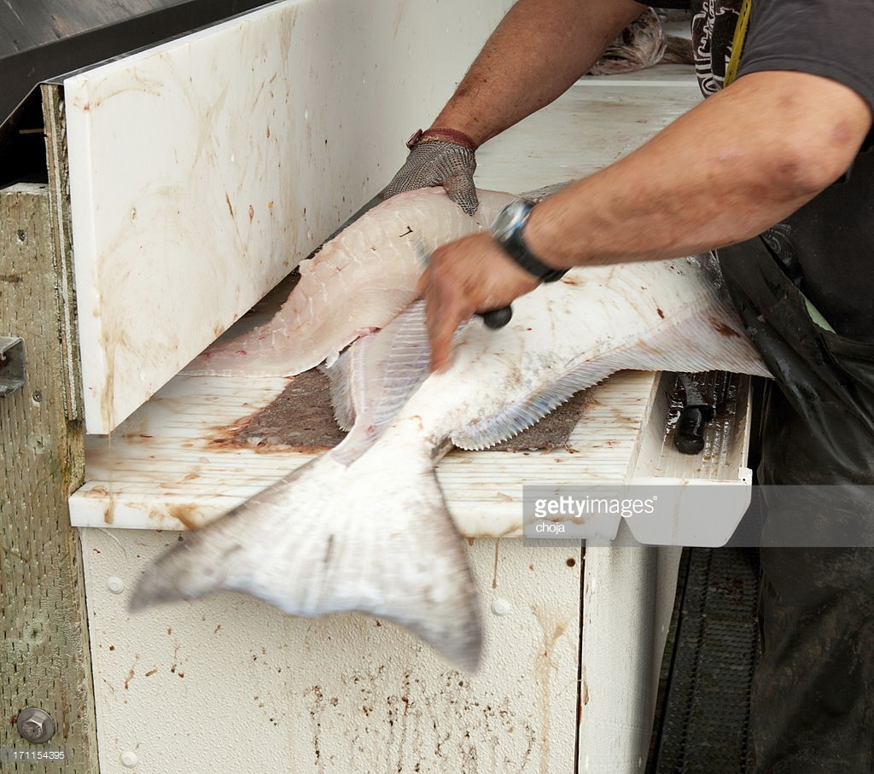
Tim Malchoff (LEC):
“In Port Graham during that heat wave of 2015 and 2016 the halibut’s meat had a consistency or texture of jelly. The halibut was like jelly and you couldn’t do anything with it. When you tried to dry the meat in the smoke house the meat would dry but it would crumble into dust and wouldn’t be able to eat it. When that halibut meat was cooked it would fall apart”

Slide 18
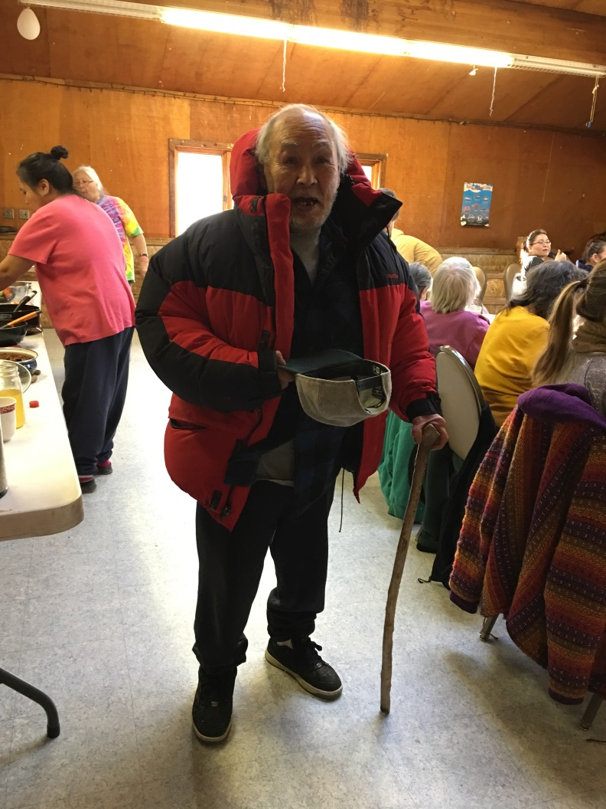
Thank you to all who have shared

