Slide 1
Clothing Summary
The local natural resources used to fashion traditional clothing incorporated elements of function, identification, and practices for the people and lifestyle of the Chugach Region.

Slide 2
Lesson Ideas for Grades PreK - 2
Furs and Feathers- Chugach puppets and Chugach Clothing from A to Z
How Warm Are Furs and Feathers?
Sinew and Stitches
Seal intestine and salmon skin
Seal Gut Parka
All About Spruce Roots
Design Your Own Chugach/Eyak Puppet

Slide 3
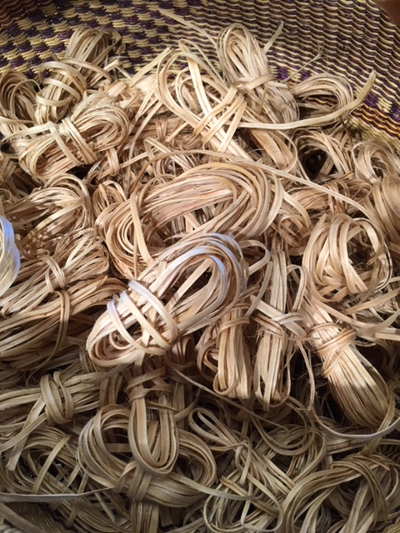
Bundles of spruce roots ready for weaving

Slide 4
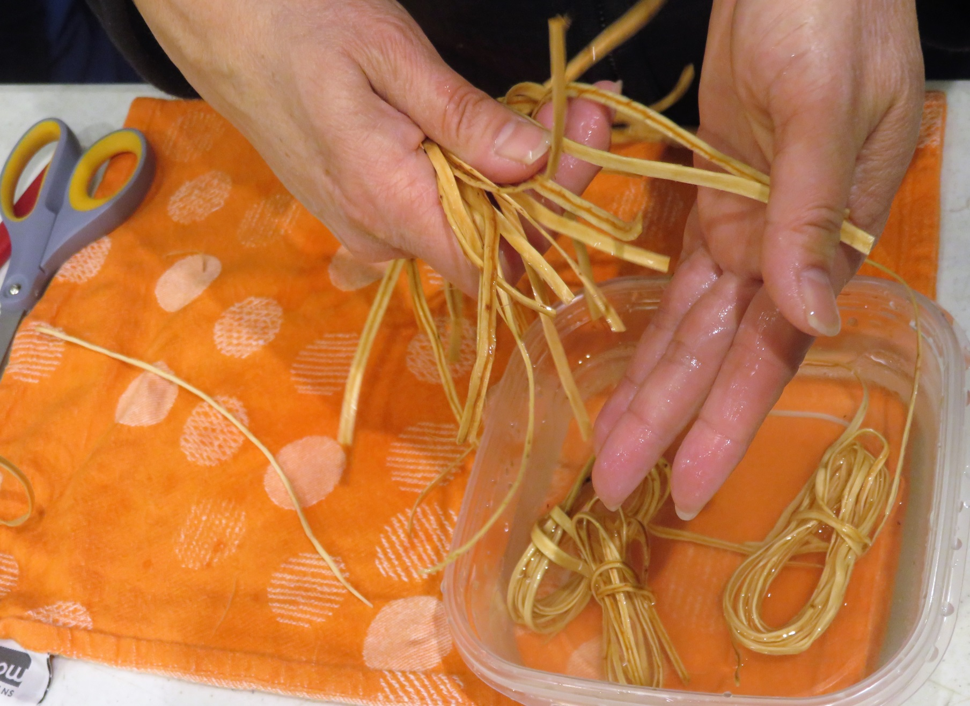
Preparing the roots for weaving. Soaking them in water so they are flexible.

Slide 5
Spruce Root lesson plan PreK - 2nd grade
Lesson Summary:
There are many traditional uses for spruce roots- birch baskets, canoes, fish traps, a variety of lashings, baskets, and hats made out of woven spruce roots. Our focus will be on the woven spruce root hats.
Enduring Understandings Approached Through The Lesson:
Our ancestors survived on the land and the sea. It was not always easy for them, but they survived through many dangerous journeys and very cold winters. They not only survived for themselves, they also survived for the future generations.
The Chugach Sugpiat and Eyak people were creative in their development of hats. They discovered that woven spruce roots made a waterproof head gear, which was necessary for the wet and cold climate of the Chugach region.

Slide 6
Spruce Root lesson plan
PreK - 2nd grade
Student objectives:
Students will learn what spruce roots are by seeing them and touching them. They will hear the words “weft” and “warp”, and learn what these words have to do with weaving.
Students will hear how spruce roots were woven to make hats.
Students will learn spruce root weaving pattern using yarn for weft and a plastic container for warp.
Resources:
Ravens tail Weaving Patterns and Projects / Ancient and Contemporary
Videos from the Spruce Root Weaving Class with Jennie Wheeler
Photographs of Spruce Root Hats

Slide 7
Lesson Ideas for Grades 3-5
Birds and Animals from the Land and Sea. Chugach Clothing from A to Z flash cards.
Sinew and Stitches-traditional expert in classroom to show how to tan salmon skin with a traditional scraper, spoon, shell.
Waterproof clothing using salmon skins and seal intestine. Show how to blow up seal intestine using pig intestine.
Spruce Root Gathering/Preparing/Weaving
Ravens Tail Weaving
Natural Dyes

Slide 8
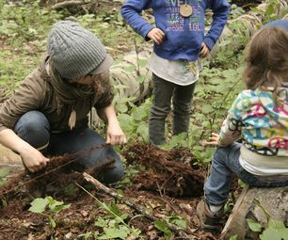
Finding the spruce roots and digging them up

Slide 9
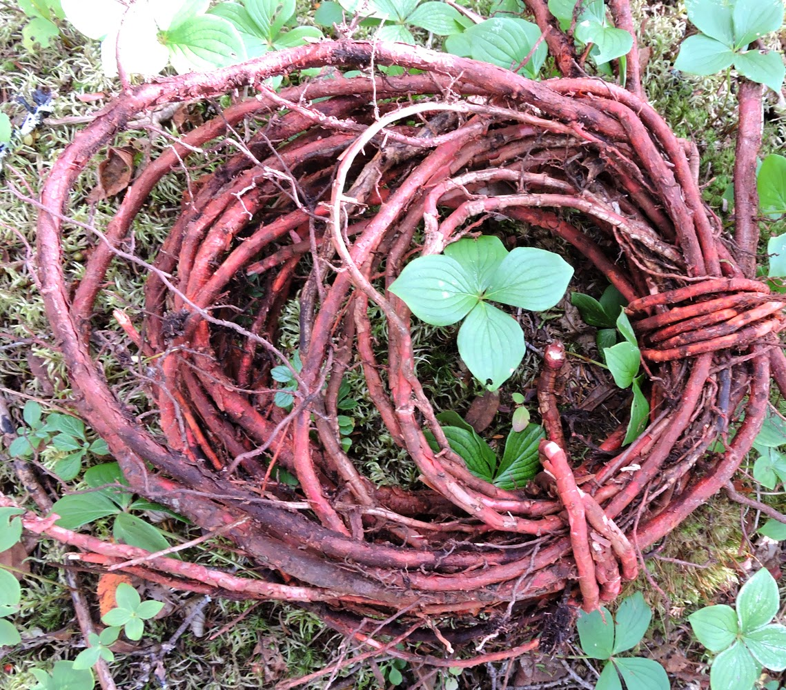
Rolling spruce roots in a coil after you dig them up

Slide 10
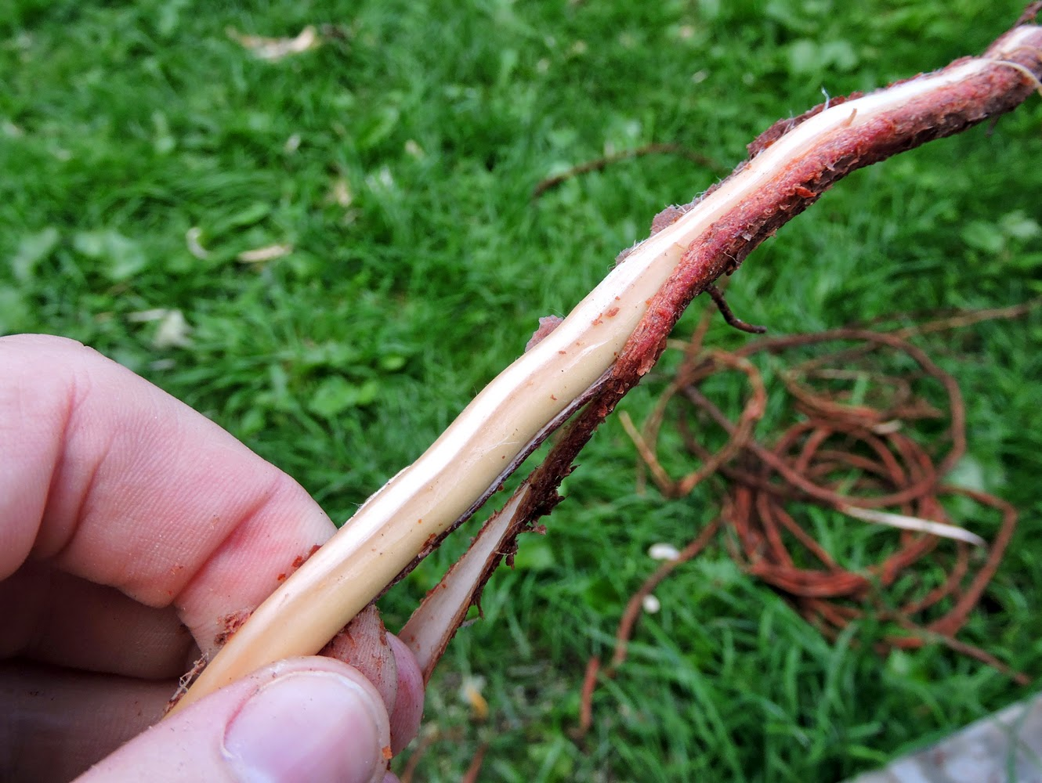
Removing the bark off the root

Slide 11
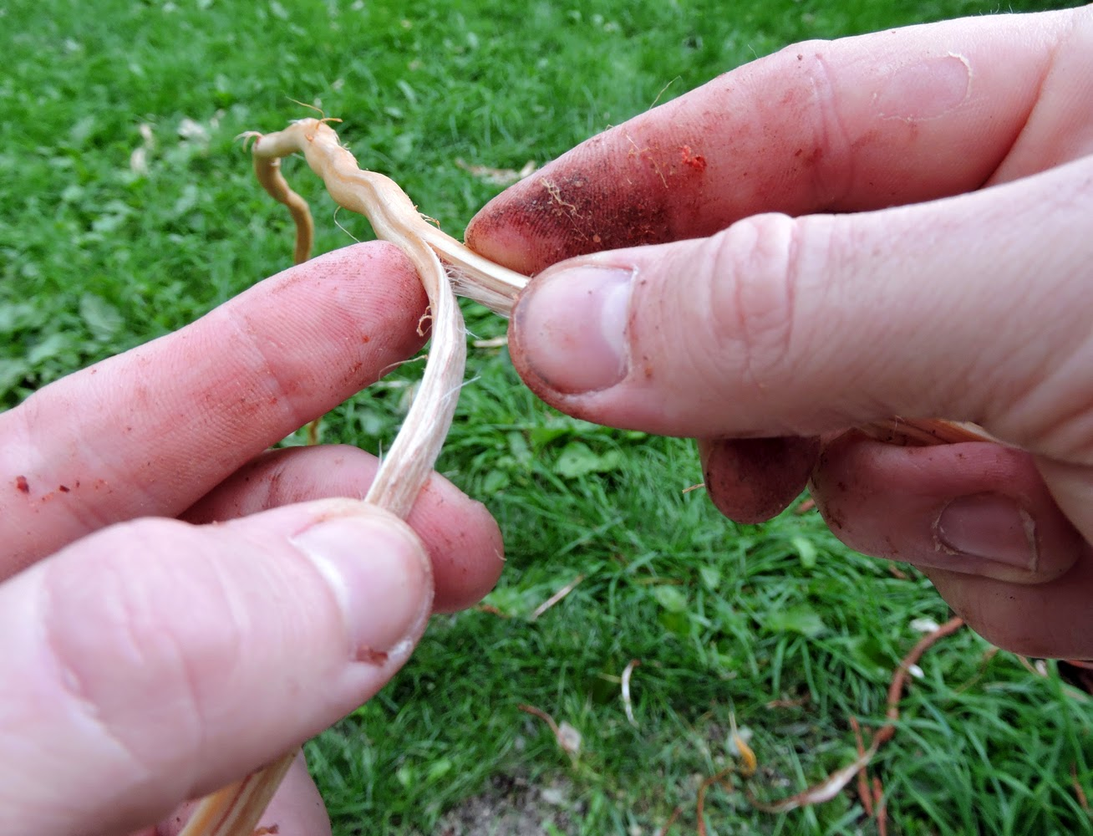
Splitting the roots

Slide 12
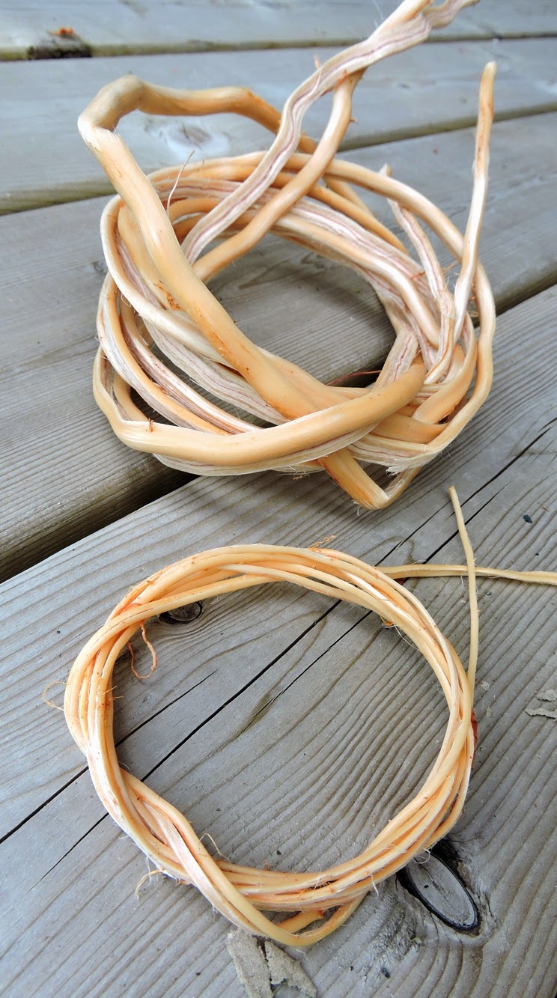
The weavers and warp ready for weaving

Slide 13
Spruce Root lesson plan 3rd – 5th
Lesson Summary:
Students will learn how to locate and gather spruce roots. Students will learn how to prepare roots for weaving.
Enduring Understandings Approached Through The Lesson:
The spruce root hat illustrates and reflects a deep knowledge of materials and the use for which the hat was made.
The Chugach Sugpiat and Eyak people have a detailed knowledge and understanding of their environment, its resources and its natural cycles, and they have developed many techniques and wearable clothing to live in that environment.

Slide 14
Spruce Root lesson plan 3rd – 5th
Student objectives:
Students will learn where to gather spruce roots
Students will learn how to harvest and prepare roots for weaving.
Students will learn the difference between weavers and warps with the spruce roots.
Resources:
Recognized Expert/Elder in spruce root gathering and preparing for weaving.
Videos and photos from the Spruce Root Weaving Class with Jennie Wheeler

Slide 15
Lesson Ideas for Grades 6-8
Chugach traditional clothing
Personal adornment of the Chugach
How to make sinew. Sinew out of deer or moose tendons.
Make a needle case and bone needle out of bone.
Traditional Chugach waterproof garments.
Spruce Root -Learn to weave with the spruce roots
Ravens tails weaving

Slide 16
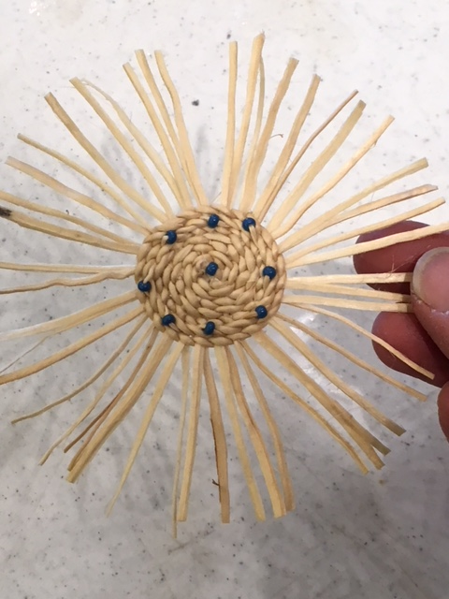
First step to learn the weave of spruce roots

Slide 17
Spruce Root lesson plan 6th – 8th
Lesson Summary:
Students will make a spruce root ornament which will teach them the traditional weave of a spruce root hat.
Enduring Understandings Approached Through The Lesson:
The spruce root hat illustrates and reflects a deep knowledge of materials and the use for which the hat was made.
The Chugach Sugpiat and Eyak people have a detailed knowledge and understanding of their environment, its resources and its natural cycles, and they have developed many techniques and wearable clothing to live in that environment.

Slide 18
Spruce Root lesson plan 6th – 8th
Student objectives:
Students will learn the difference between a weaver and a weft.
Students will learn how to weave with spruce roots.
Students will learn the traditional weave of a spruce root
Resources:
Recognized Expert/Elder in spruce root gathering and preparing for weaving.
Videos and photos from the Spruce Root Weaving Class with Jennie Wheeler

Slide 19
Lesson Ideas for Grades 9-12
Sewing Kit – for both the women and the men. Make a traditional bag and a needle case with thimble.
Seal intestine and the waterproof stitch. Study the Chugach seal intestine parka that is from Makarka Point and is on display in the Ilanka Museum. As a class reproduce the gut parka. Kodiak Alutiiq Museum video on the reproduction of the parka in the Etholen collection located in Finland.
Study traditional spruce root hats from our region-making a doll size spruce root hat.
Ravens tail weaving-thigh spinning. Learn to spin wool with cedar bark.

Slide 20
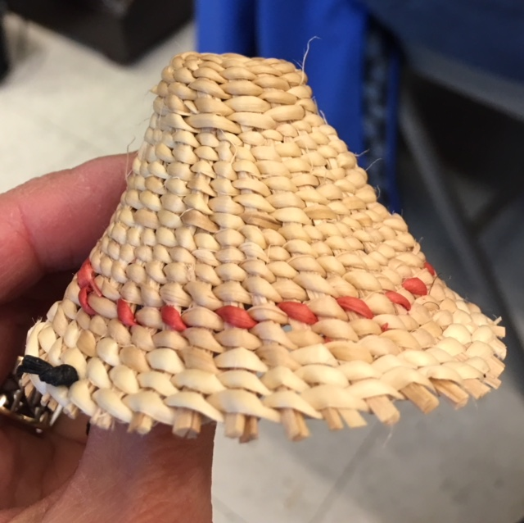
Woven Doll Spruce Root Hat

Slide 21
Spruce Root lesson plan 9th – 12th
Lesson Summary:
Students will study the Chugach region spruce root hats. Student will make a spruce root hat for their Chugach doll using a traditional design from our region.
Enduring Understandings Approached Through The Lesson:
The spruce root hat illustrates and reflects a deep knowledge of materials and the use for which the hat was made.
The Chugach Sugpiat and Eyak people have a detailed knowledge and understanding of their environment, its resources and its natural cycles, and they have developed many techniques and wearable clothing to live in that environment.

Slide 22
Spruce Root lesson plan 9th – 12th
Student objectives:
Students will learn how to weave with spruce roots.
Students will learn the traditional design of a Chugach spruce root hat.
Resources:
Recognized Expert/Elder in spruce root gathering and preparing for weaving.
Videos and photos from the Spruce Root Weaving Class with Jennie Wheeler

Slide 23
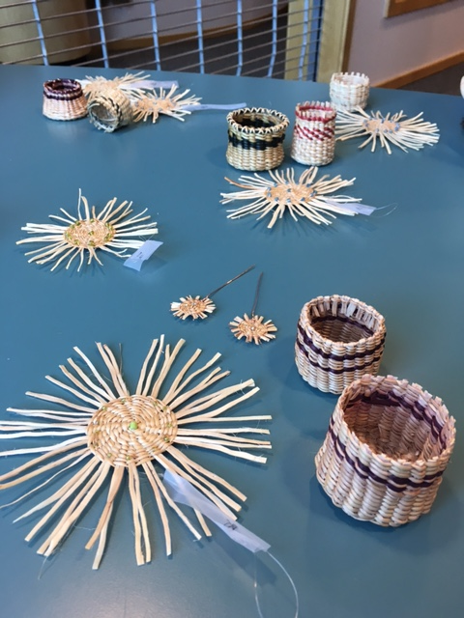
Spruce Root Creations

Slide 24
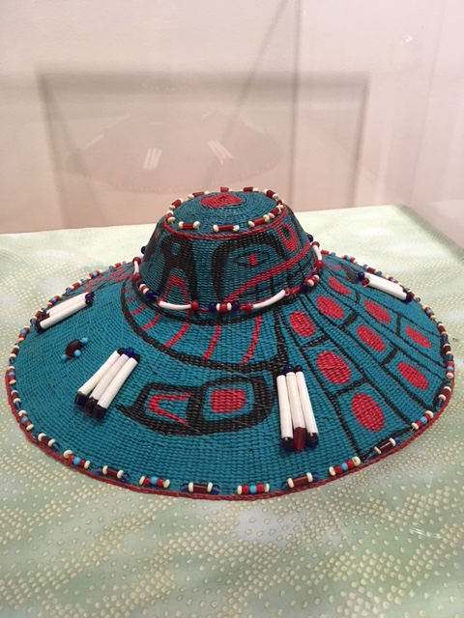
Ilanka Cultural Center Spruce Root Hat- Woven by Dolly Garza

Slide 25
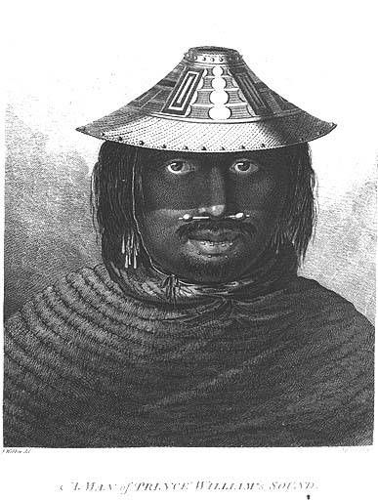
Prince William Sound
Man Wearing a Spruce Root Hat

Slide 26
www.tracingrootsfilm.com

