Slide 1
FOOD FROM THE
SEA
Barclay Kopchak
LEC, Cordova

Slide 2
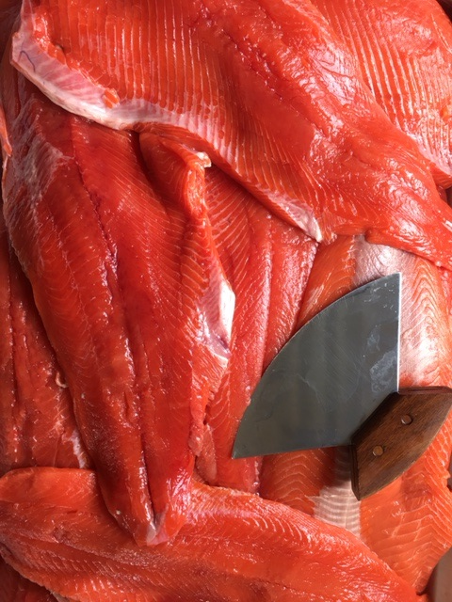
Pre-K – S Themes
Our Place – Why here?
Our Subsistence Heritage
What’s here?
Where to harvest?
How to share?

Slide 3
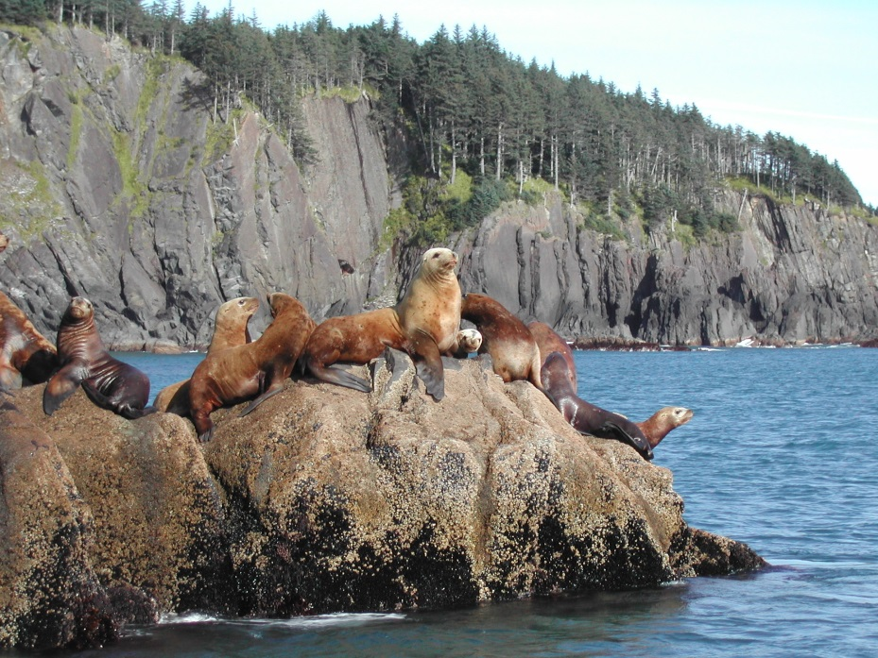
3 – 5 Themes: Our subsistence heritage
Near Shore and Far
Sharing and Preserving

Slide 4
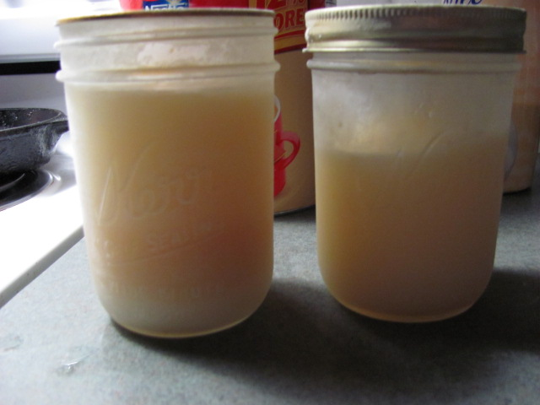
6 – 8
Themes:
Our changing subsistence world
Our adaptability
Our heritage preservation

Slide 5
6 – 8
SEALS & SUBSISTENCE
Project Goal: To tell the story of Sugpiat/Eyak seal harvesting and usage as described by Sugpiat/Eyak Elders, seal hunters through illustrative posters

Slide 6
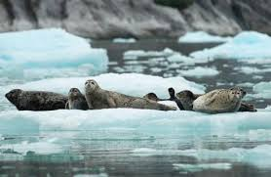
Classes 1 & 2:
Listen to Elder descriptions of seal hunting and usage;
Use kit library, websites, and Elder quotations from “Seal Research Sources” handout

Slide 7
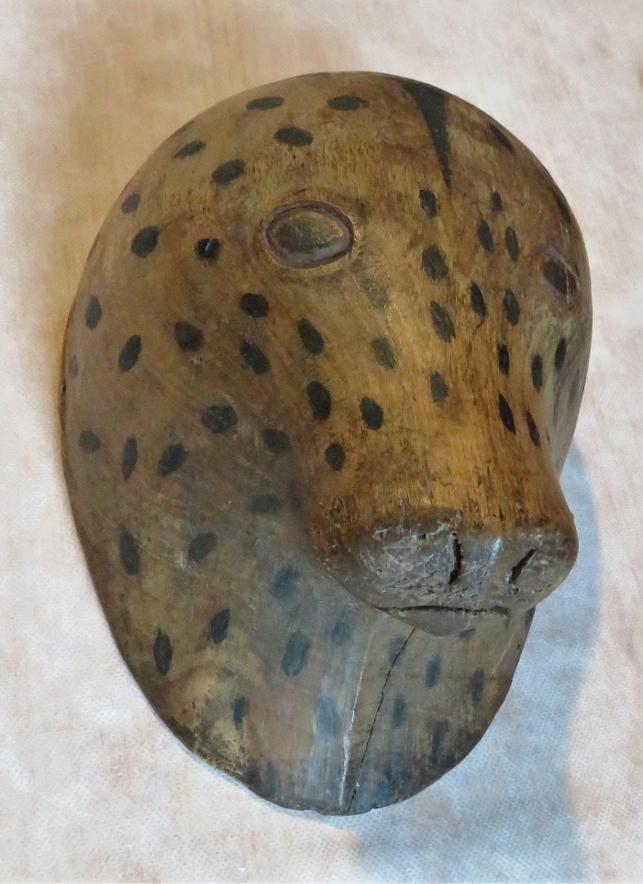
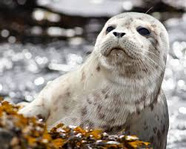
9 - 12
Class 3:
Select Elder quotations to tell the story of seals and subsistence

Slide 8
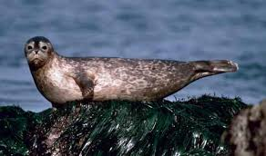
…, you would pick a point outside of the glacier and sit on the shore and wait for in-coming and out-going seal. They generally went with the tide.
- Bobby Stamp
Because the seal was far ranging, geographically speaking, hunters has to travel great distances, by kayak or in later years by rowboat.
- Derenty Tabios
I used to go seal hunting with my grandfather Willie Kompkoff, my Uncle Richard, and my dad, I would be tucked inside a bidarka.
- Paul Kompkof, Sr.

Slide 9
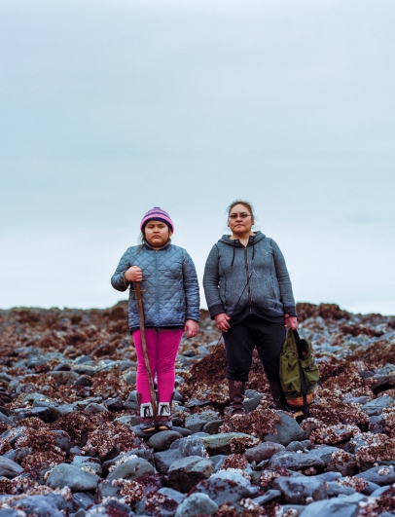
9-12
Themes:
Subsistence sustainability
Our adaptability to change
Our traditional conservation measures
Respect and regulation

Slide 10
9 – 12
9-12
OCTOPUS
“Paul Kompkoff, Jr: That’s the way he catches octopus. He stuck a stick under the rock, and if it moves, there’s an octopus down there.
Don Kompkoff, Sr: Another way to catch an octopus: we’d stick a stick in [a hole] and just watch it. If it starts moving, he’s in the hole.
Michael Vigil: I’ll be darned. That’s a good way.
Nicholas Wilson: I heard that a long time ago, before they had Chlorox, because I know that’s what you use now to get the octopus to come out. Somebody told me they used to pee in the hole to get the octopus to come out.”
- Chenega Diaries

Slide 11
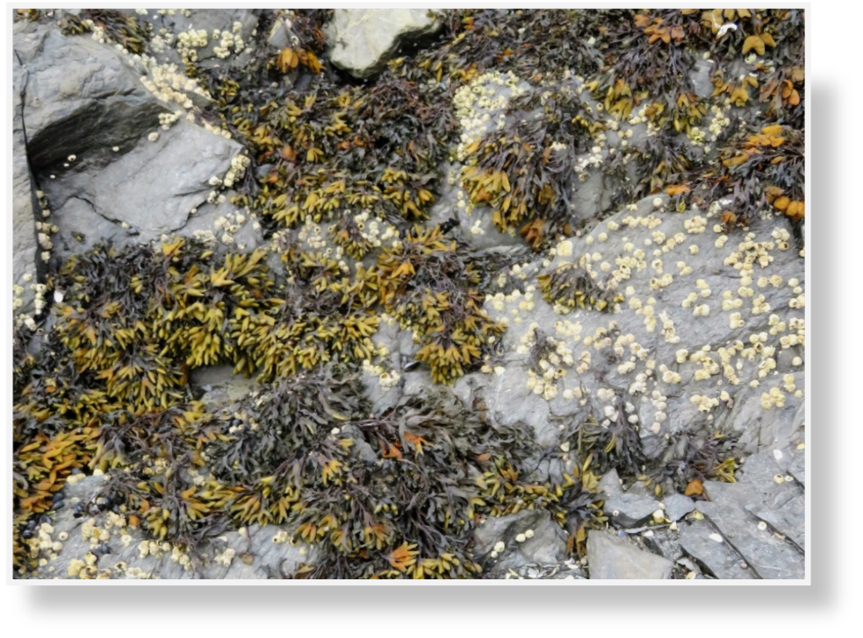
9-12
SUSTAINING SUBSISTENCE
Identify popular food from the sea harvested locally
Interview Elder regarding harvest methods
Research and correlate relevant state and federal regulations
Make a proposal to Board of Fish or a poster to promote the sustainability of this traditional harvest

