Slide 1

HONORING
EYAK

Slide 2

The HONORING EYAK Heritage Kit seeks to recognize the voices, heritage, and spiritual journey of the Eyak existence.

Slide 3

3 Main Areas of Interest
EYAK Identity
Distinctive EYAK Characteristics
EYAK History

Slide 4

Who are the EYAKS?

Slide 5

When did you first learn or realize that you were Eyak?
How is your Eyak identity important to you?
What are you proud of as an Eyak? What makes you proud to be Eyak?
Has your sense of Eyak identity changed over time? If so, how?
When and where, if ever, did you hear Eyak spoken?
Why do you feel that the language was lost?
How do you feel about the efforts to revive Eyak?

Slide 6
DISTINCTIVE EYAK CHARACTERISTICS

Slide 7
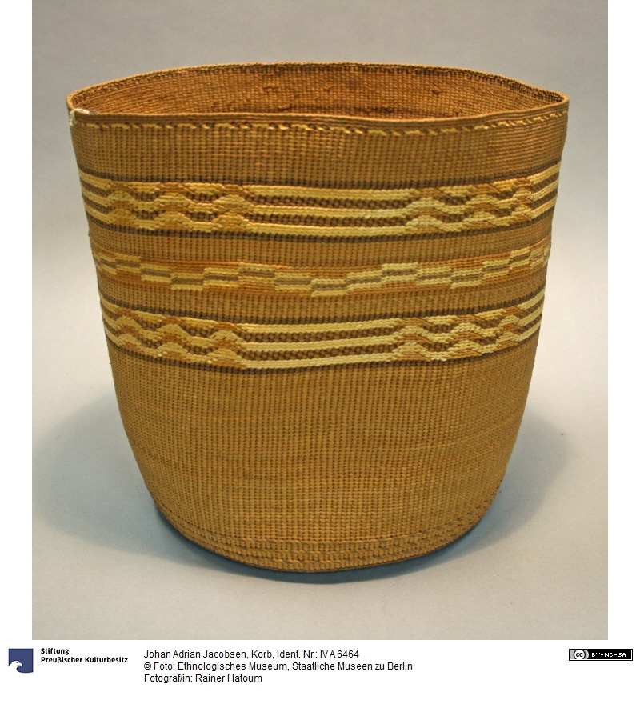
- How do you describe being Eyak?
- Are there personal or spiritual qualities that define what it is to be Eyak?
- Do you know how traditional Eyak families & villages were organized?
Do you have a family clan?
How is your clan determined?
- Can you recognize Eyak artifacts by any clan markings,
distinctive style, or ornament?
- Are you aware of goods
traditionally produced
by the Eyaks?

Slide 8
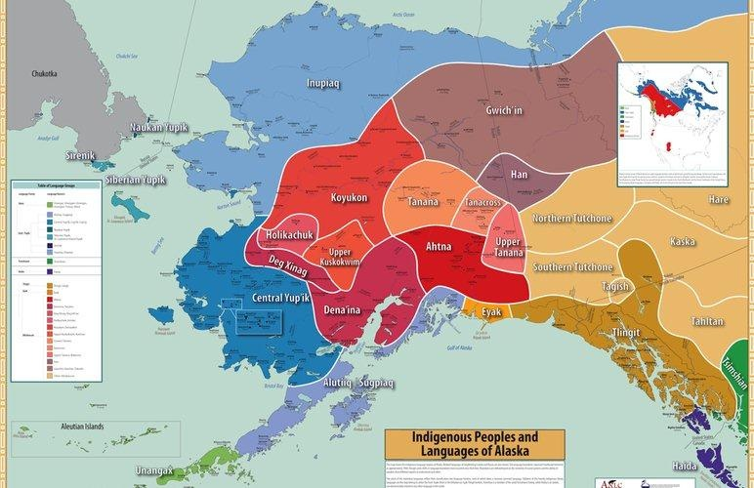
Eyak History

Slide 9
What historical events origins shaped our existence in the Chugach Region?
Have you heard any stories about where the Eyaks came from or their role in local history?
What Eyak village sites, graves, hunting areas are you aware of?
What were the Eyaks’ relationships with neighboring tribes?

Slide 10
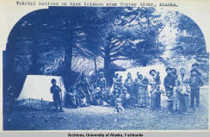
Awa’ahdah!

