Slide 1
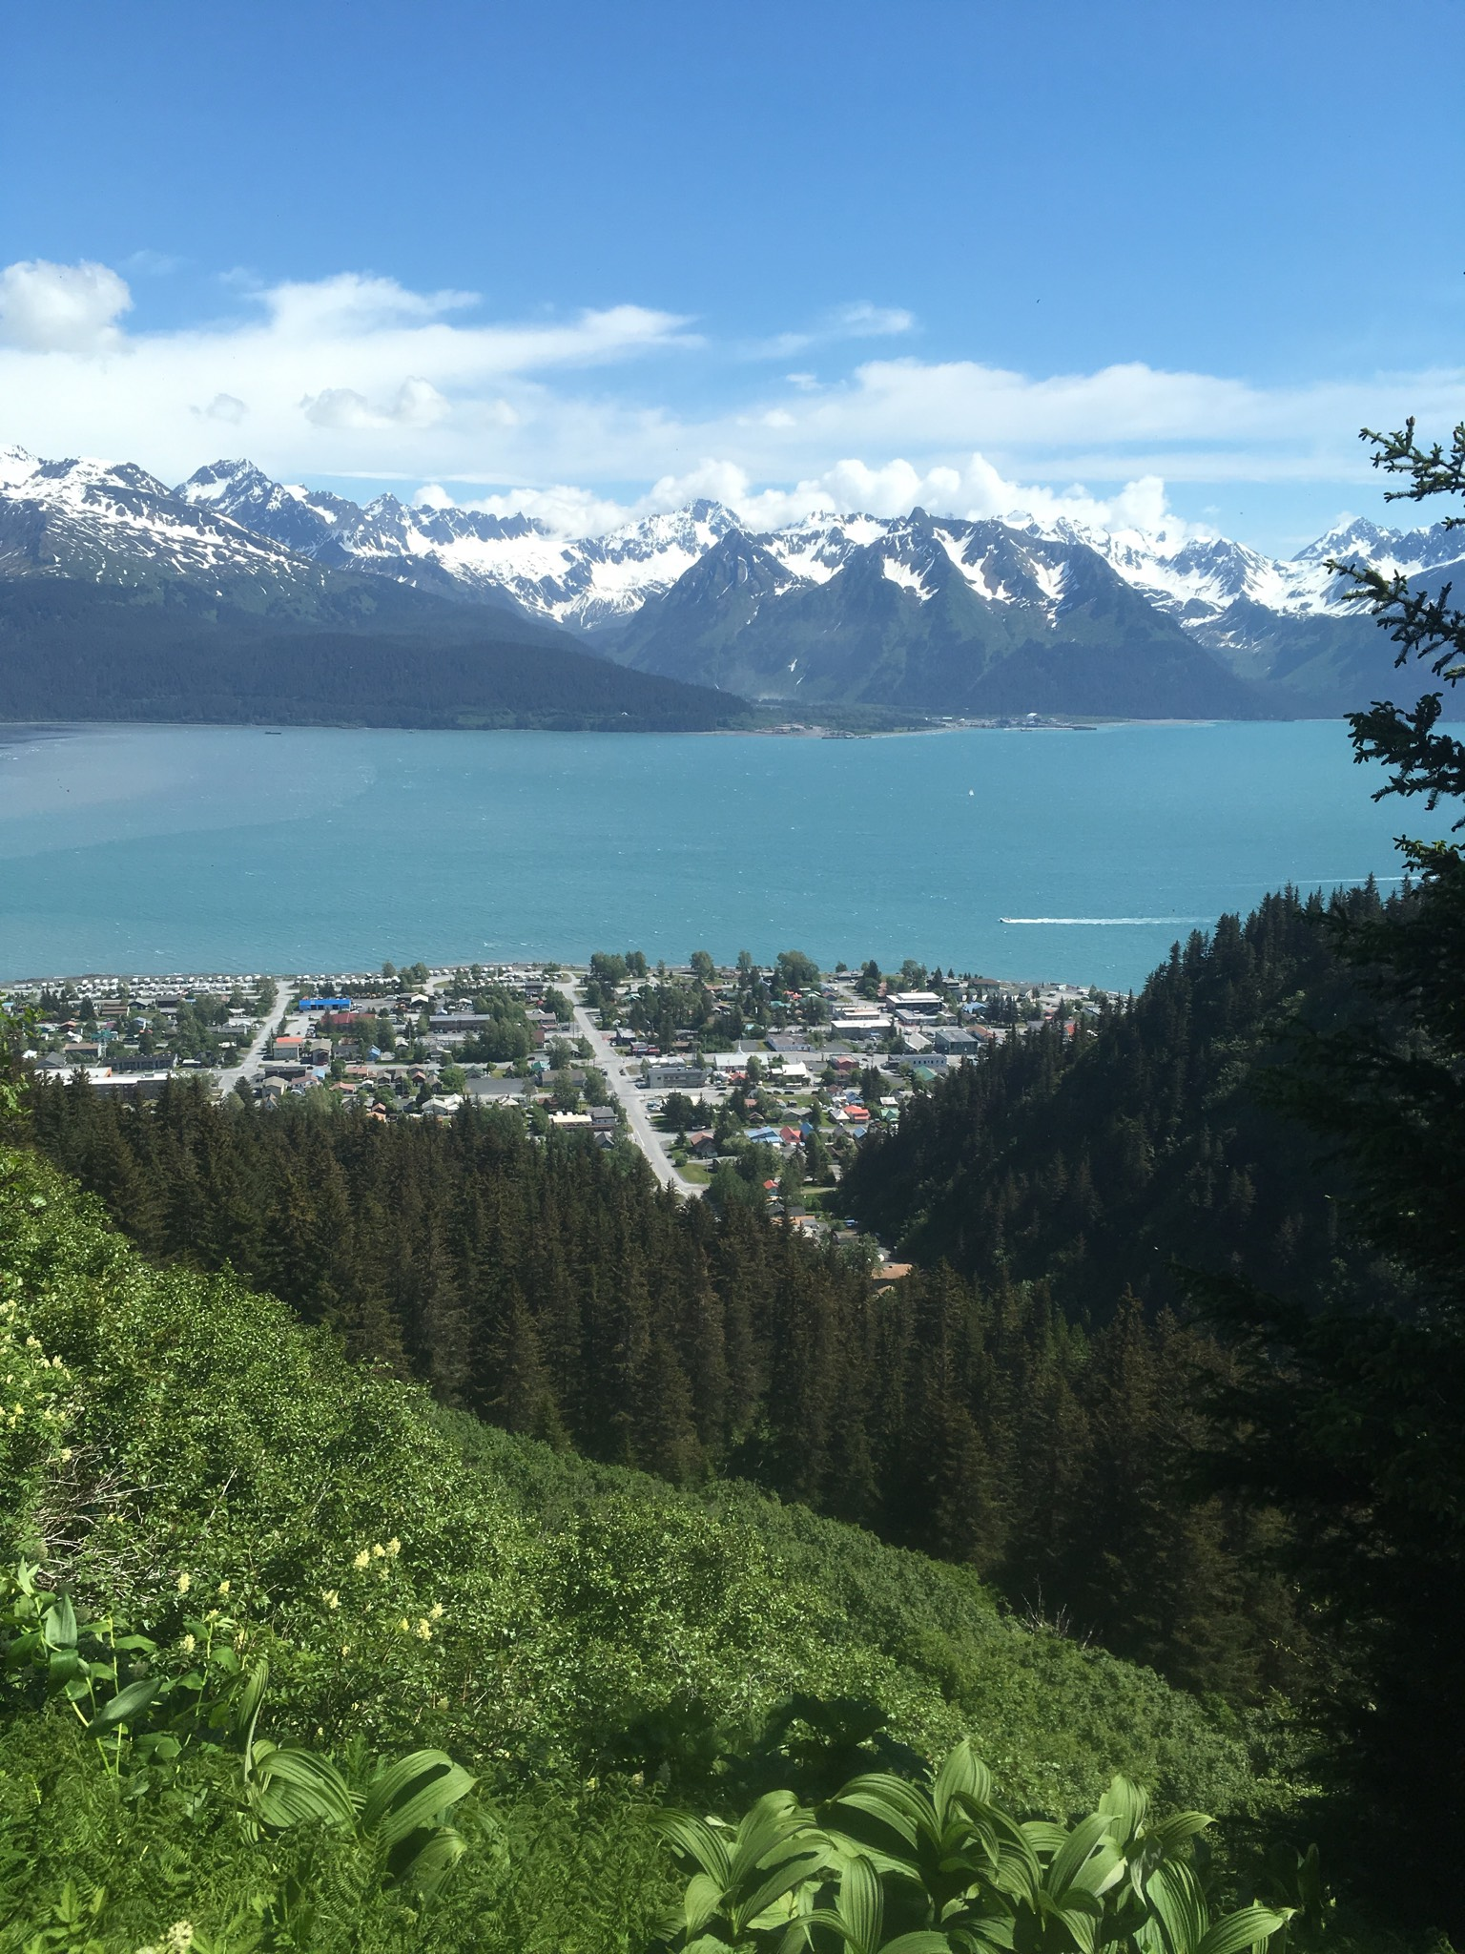
Our Water
“Merpet”
Nick Jordan
Local Education Coordinator
Seward
NicholasJ@chugachmiut.org

Slide 2
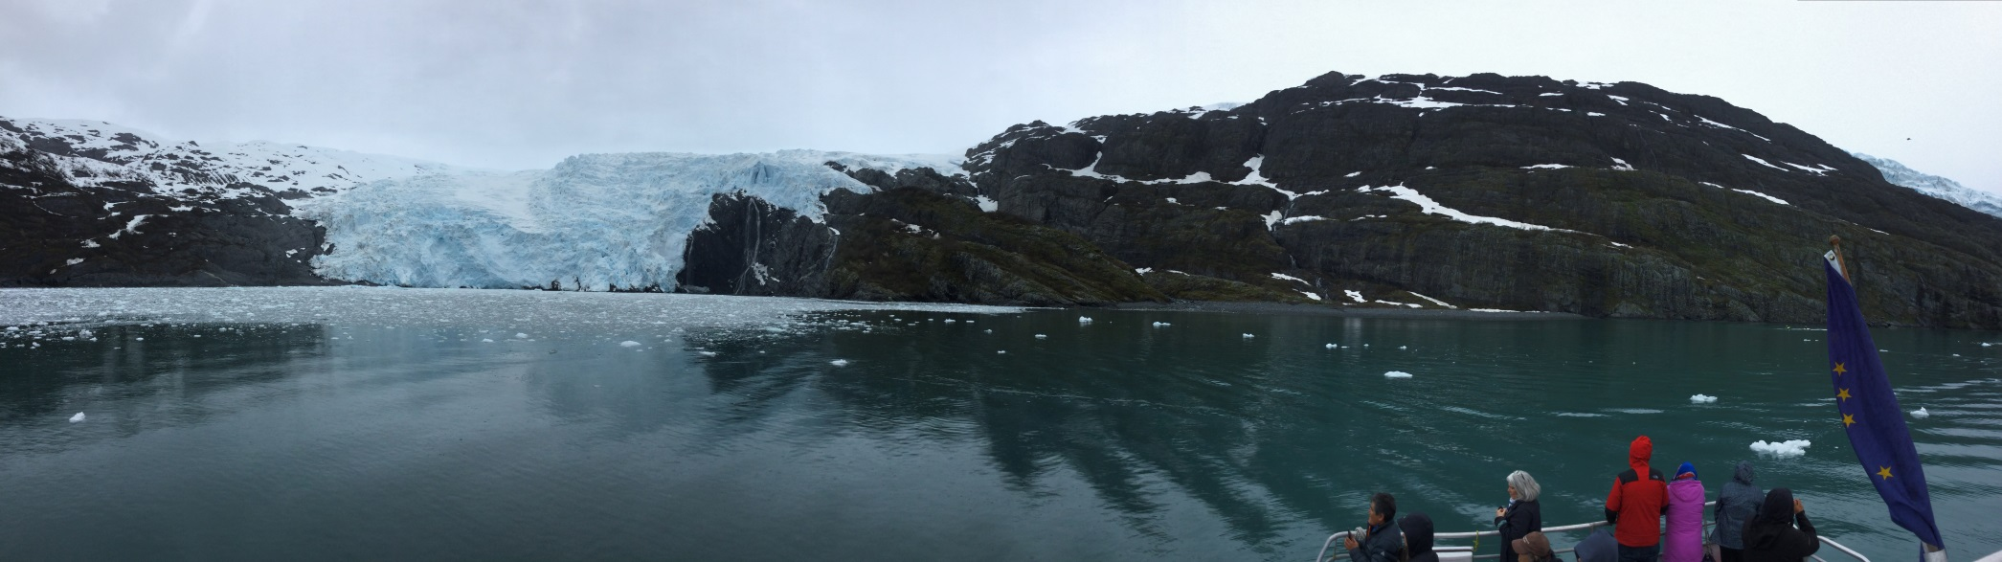
“ The only thing that connects us all is water, and if your ever alone all you have to do is put your hands in the water, and your connected all the way around this world.”
Bill Smith (Valdez/Cordova, Alaska)

Slide 3
Enduring Understanding
  Healthy watersheds are vital to our way of life.
  Essential Questions:
    Where does our water come from?
    How do we keep our watershed healthy?
    How does the watershed impact our subsistence way of life?
    Are we seeing changes in the watershed?

Slide 4
Overview
Watersheds in the Chugach Region have sustained the Sugpiaq and Eyak people for generations.
Our watersheds are delicate systems that hold many species, nurture spawning grounds, and provide food for people and animals.
Our watersheds have seen an increase in pollutants, oil spills, over harvesting of fish, timber, and animals.
Each watershed has different characteristics, and each part is vital to the health of the system.

Slide 5
Lessons for Watershed kit
K-2: Fresh Water Web
Fresh water flows all around us, down rivers and streams, mountain springs, through the pipes in our homes. How do we use all this fresh water around us, and where does it go when we are finished using it?
3-5: Watershed and Water Filer
Our ancestors throughout the Chugach Region have collected water from different areas in the landscape. Water for drinking, cooking, bathing and cleaning was hauled from springs and clean streams, and lakes, year round. Were different water sources used for different activities? Such as drinking water and bathing water? How did our ancestors know the water was clean? How was water collected and transported in your community. Clean water is vital for our health and the health of the animals we depend upon.
6-8: Hauling Water:
Each community in the Chugach Region accesses fresh drinking water from different types of water sources. How did your ancestors haul and store water? Clean water is vital for the health, sustainability and safety of the village. The modern convenience of running water is easy to get used too. Traditionally water had to be hauled using various methods from water sources to camp or home each day.

Slide 6
Lessons for Watershed kit ( cont.)
9-12: Documenting Our Water; Poster Project
Develop a researched Poster to be submitted to the Alaska Marine Science Symposium student poster project.
1) In small groups pick four topics from the list provided below. Develop a poster based off a typical poster board size 22”x28”. Your poster will be based on the Elders TEK about your community’s watershed.
2) Information for your poster will also include scientific research, watershed exploration, and photography or graphics.
3) Include Sugt’stun and/or Eyak vocabulary.
4) Elder quotes from interviews.

Slide 8
Watershed Monitoring and Stewardship Projects
Contact a local watershed organization to develop a multi week project in partnership with local Elders sharing Traditional Educational Knowledge. (A list of organizations will be included on the website)
Examples:
1)Copper River Watershed Council
  Fishwatch
  https://copperriver.org/programs/fish-habitat-restoration/fishwatch/
  Salmon Blitz
  https://copperriver.org/programs/fish-habitat-restoration/salmon-blitz/
  2) Alaska Sea Grant (Stewardship Project Ideas)
  http://aswc.seagrant.uaf.edu/resources

Slide 9
Video and/or Audio Interviewing of Elders
  Historical knowledge is important to understanding the changes to our environment. Our Regional Elders hold vital Traditional Ecological Knowledge (TEK) provide us with clues to the changes in watersheds and environment. For this lesson you will develop a list of interview questions to gather information from Elders in the area.
  Developing high quality interview questions are essential to gathering information and stories. The links will help guide you in developing questions and a quality interview process:
  http://www.thewildclassroom.com/wildfilmschool/gettingstarted/interviewquestions.html
  https://web.stanford.edu/group/ethnoger/AppC.pdf
Recording using iPad, or mobile device……
  https://delta.ncsu.edu/knowledgebase/recording-professional-quality-videos-with-ipad/

Slide 10
Resources
Regional Elder Interviews
Kachemak Bay National Estuarine Research Reserve (KBNERR)
  Story Maps
Alaska Sea Grant
Adapt Alaska
Kenai Fjords National Park
  Kenai Fjords National Parks Watershed Projects and Glacier monitoring.
  Chugach Regional Resource Center
Copper River Watershed Project
Prince William Sound Science Center
Department of Fish and Game
Seward-Bear Creek Flood Service Area (SBCFSA)

Slide 11
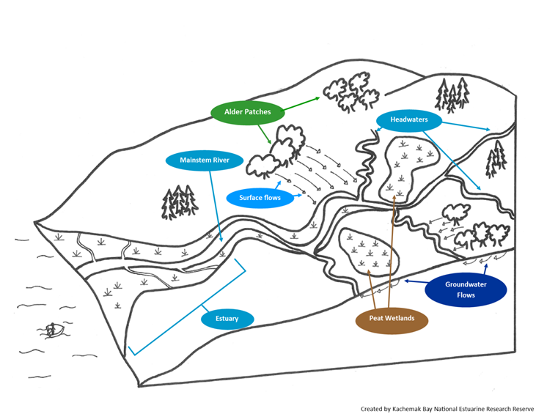
Elder Interviews
  If you have suggestions for Elders in your communities whom have a strong connection with the watershed, please share their names.
Credit: Kachemak Bay National Estuarine Research Reserve

Slide 12
Interview Questions for Regional Elders
A watershed consists of glaciers, snowpack, small and large streams (known as tributaries) that flow from the mountains, down the valleys, into lakes, ponds, and wetlands and finally ending in the mixing zone at the ocean; this area is also known as the estuary.
1) What does watershed mean to you?
2) Do you know it as a different word or term?
  In Eyak or Sugt’stun?
3) What would you like younger generations to know about your local watershed?
  a) Important places
  b) Critical animals, birds, fish, etc.
  c) Any other concerns?
4) In your lifetime have you noticed changes in your local watershed?
  a) Human impacts?
  b) Environmental changes?

Slide 13
Continued
5) In your community what types of resources (foods, clean drinking water, materials, economic opportunities) does the local watershed provide to you and your community?
6) Estuary is the tidal zone where the freshwater meets the saltwater and has been described as “the place where life begins”.
How does this statement relate to your community’s relationship with it’s watershed?
7) Do you collect any foods (plants, fish, shellfish, etc..) from the estuary? If so, what types of food?
8) Do you have any stories that have been passes down about the watershed, estuary, or protecting watersheds?
9) Does the local watersheds pose a risk or hazard to the safety of your community?
  a) What type of concerns?
  b) Past events? What caused this particular event?
  c) How about human caused concerns?
10) What types of concerns do you have for the future of your local watershed?

Slide 14
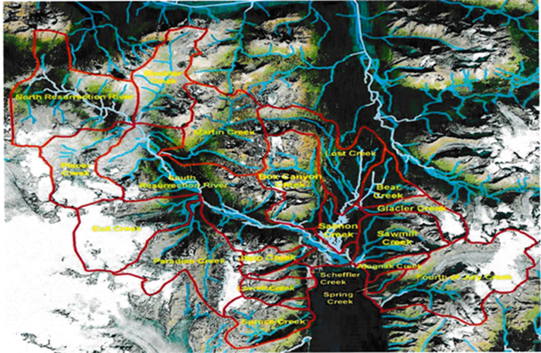
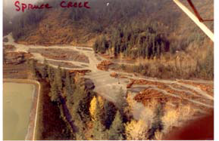
Thank you
Special thanks to
Regional Elders
Kachemak Bay National Estuarine Research Reserve (KBNERR)
Syverine Bentz, Jacob Argueta, Chris Ghu
Alaska SeaGrant
Marilyn Sigman
Seward Watershed Map (KFNP)

