Slide 1
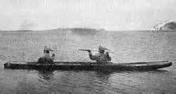
Traditional Place Names
Nunapet Atriit
By Tim Malchoff
Port Graham
Local Education Coordinator

Slide 2
“During Pre-contact time, there were seasonal villages in Prince William Sound. Over the centuries, our ancestors established various settlements. Traditional place names connect the Sugpiaq and Eyak people to our long history in the Chugach Region.”
Enduring Understanding and Essential Questions
Essential Questions:
Where are the Traditional Place Names located?
What are the stories about the abandoned villages/communities?
What are the connections between traditional place names and there use?
How does pre-contact and present day differ?
Other question: What purpose, event or place that made it memorable?

Slide 3
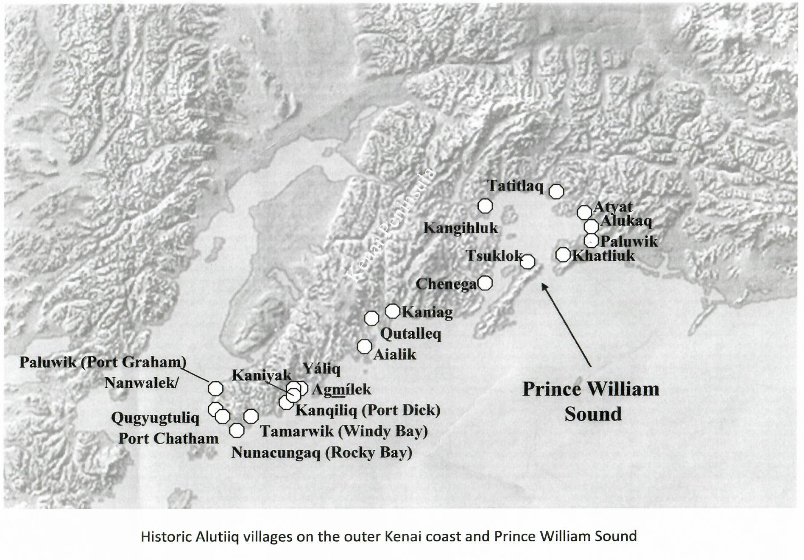

Slide 4
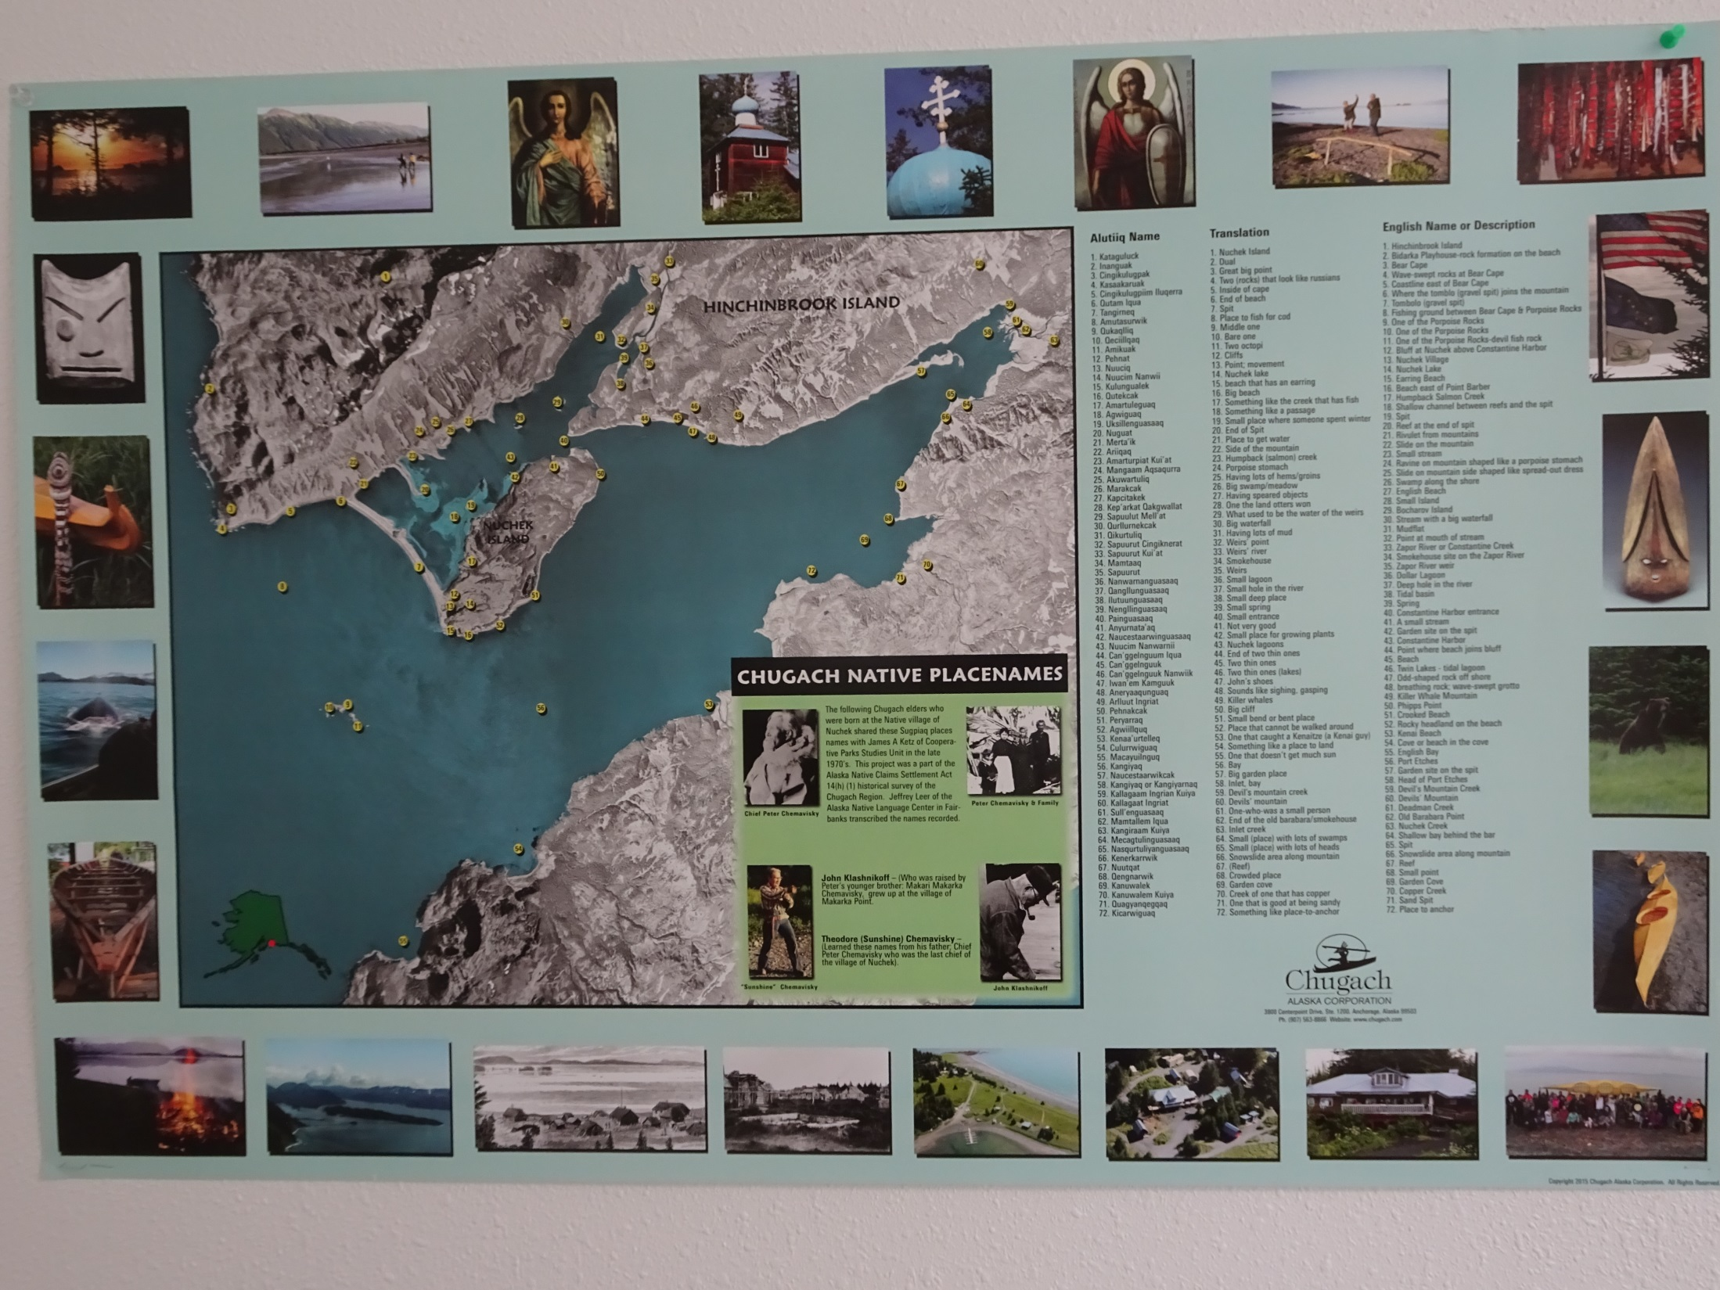

Slide 5
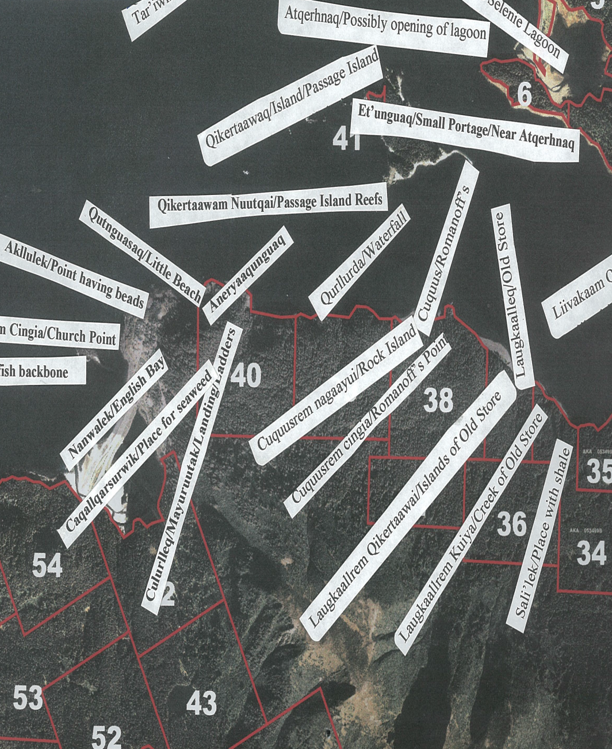
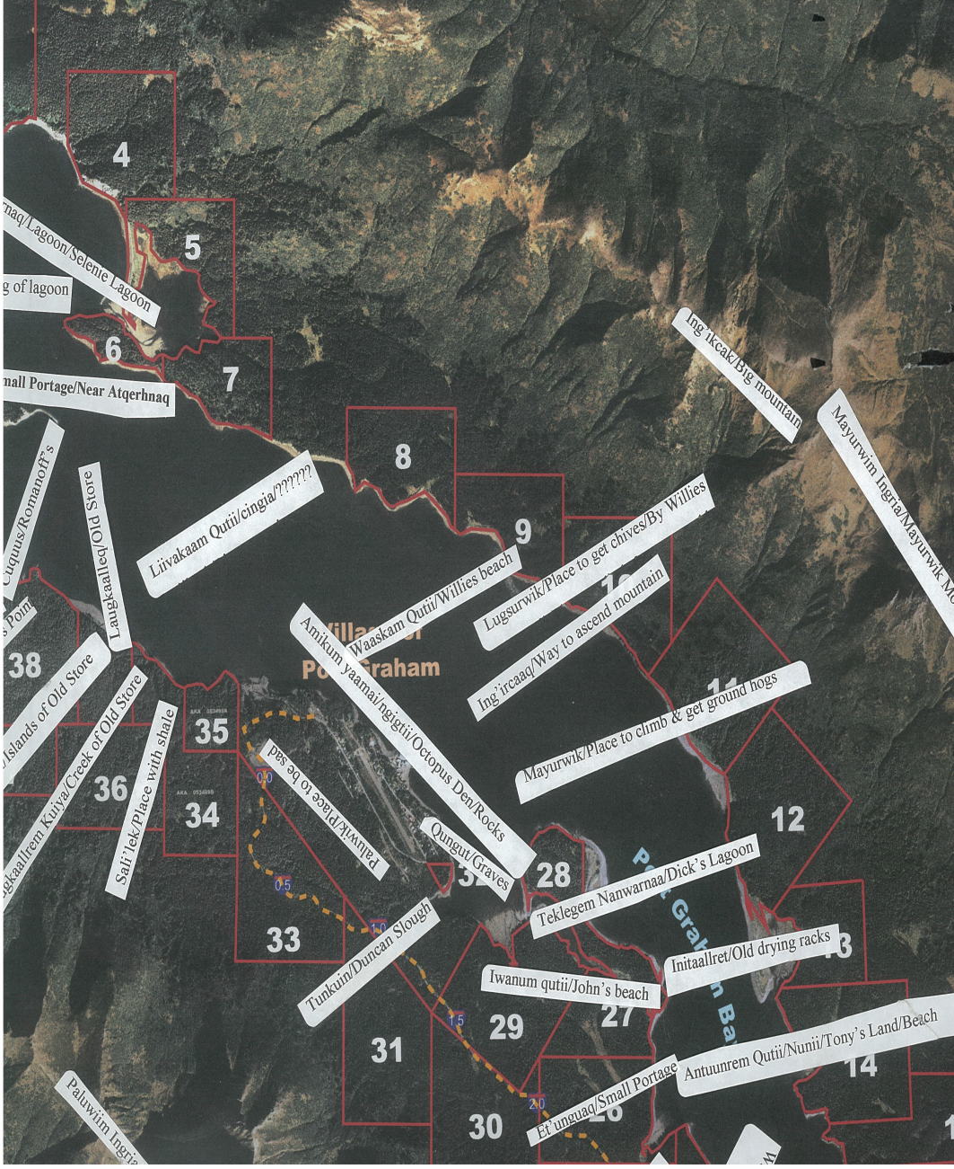
Traditional Place Names in Port Graham

Slide 6
Online Maps
https://apps.simtable.com/Clipboard/?id=CHTim_ChugachRegion_3133#MapWindow – Chugach Region
https://eloka-arctic.org/communities/yupik/atlas/index.html - Yupik Place Names
http://web.kpc.alaska.edu/denaina/pages/vocabulary_pages/houses_shelters_caches.html - Dena’ina and Athabascan Place Names

Slide 7
Curriculum for Traditional Place Names Activity lessons
History of the Chugach Region
Who are we ? Where did we come from ? How did we get to where we are now?
Timelines of Events
Abandoned Villages and Seasonal Settlements
What are the stories about abandoned villages?
Migration
Present day Villages and Communities
The history of the community, first establishment and first people.

Slide 8
Suggested Topics for Curriculum
Stories of why villages and towns were abandoned
Timeline of events in the lower cook inlet and prince William sound
Origins of migration
Seasonal settlements
History of present day communities with recognized community members
History and stories of first contact with communities and the establishment of those communities.

Slide 9
Timeline of events in the Chugach Region
Lower Cook Inlet
1785, Russian ort established at Alexandrovsk (Nanwalek)
1786, Portlock and Dixon visit and map Lower Cook Inlet
1855, Coal mine established at Port Graham Bay
1874, Nicholas Moonin born in Nanwalek, Father and Grandfather of a large portion of population in Nanwalek.
1870, Yalik residents moved to Nanwalek.
1915, Port lock established
1950 Portlock abandoned, residents move to Port Graham and Nanwalek
Prince William Sound
1741-1867, The exploration of the Russian Fur Trade period
1867, Alaska is sold to the United States.

Slide 10
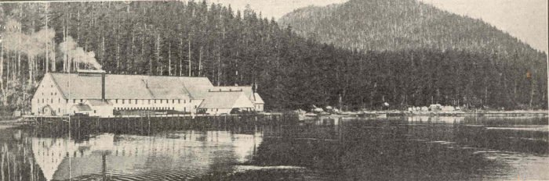
Stories of Abandoned Villages
Port Chatham
This tiny remote area is located on the Kenai Peninsula, most nearby to the well-known town of Homer far outside of Kachemak Bay State Park.
This remote place in the middle of the ocean was first inhabited in 1787 as part
of the British Royal Navy. After the first post office was established in the 1920s,
it was said that the evil spirit or creature haunted the nearby mining camp of Chrome,
which is abandoned today

Slide 11
Stories of Abandoned villages
Because this evilness was said to walk on two feet, that diminished the odds of it being a more predictable predator such as a bear or a wolf. Many claim that it was Bigfoot, Yeti or Sasquatch. It is also said that there were many trees throughout the area that were completely ripped out of the ground and turned upside down, with the roots facing up into the air. This was thought to be more proof that whatever this evil creature was, it was too powerful for any human or village to stop.
During the 1940s, at the height of World War II, bodies in and around Portlock began turning up in nearby rivers, lagoons and trails near the town. These bodies were said to be completely mutilated and essentially torn to shreds. People also began disappearing out of nowhere and never returning home, for years on end. By the 1950s, locals were sick and tired of living in fear so they completely fled the town and left it abandoned. Years later when hunters returned, it is said that they reported seeing 18-inch long human-like footprints

Slide 12
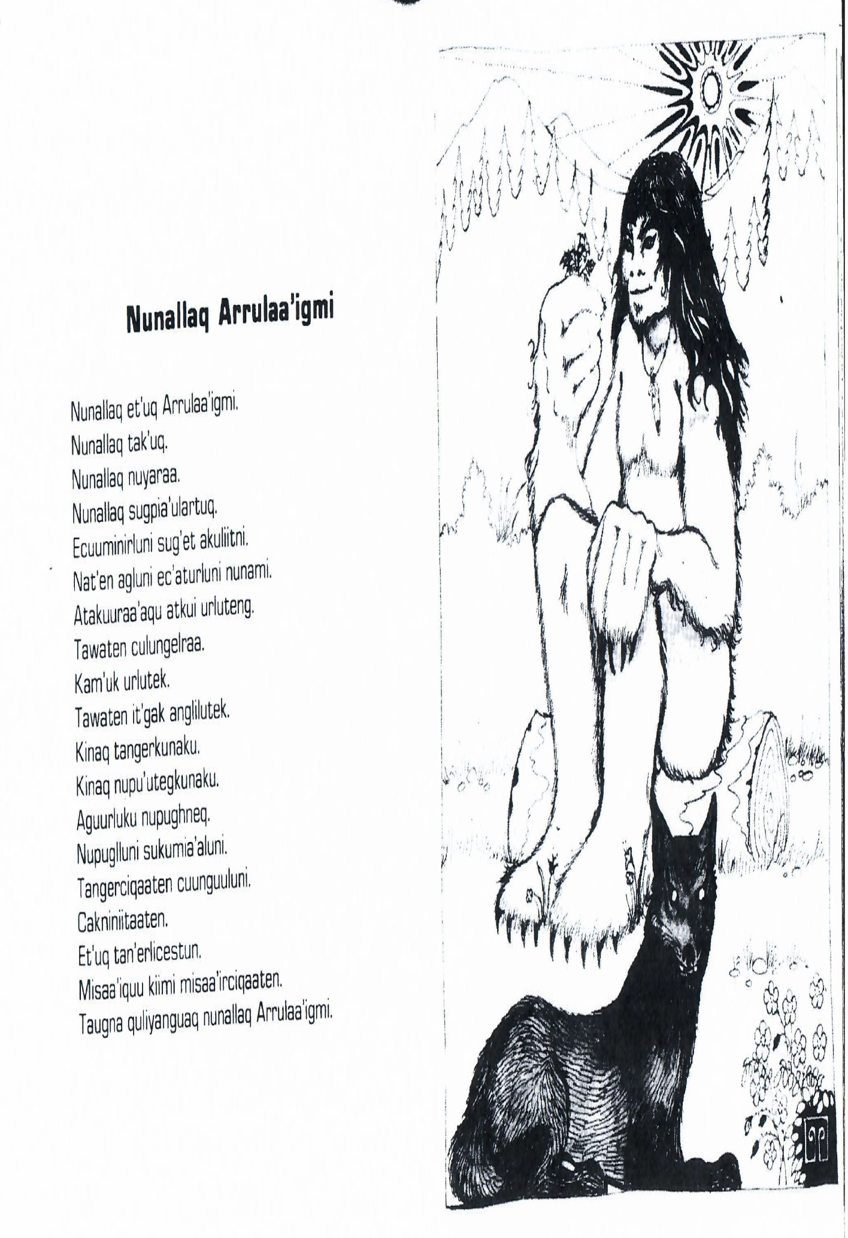
Old Beliefs in Port Graham

Slide 13
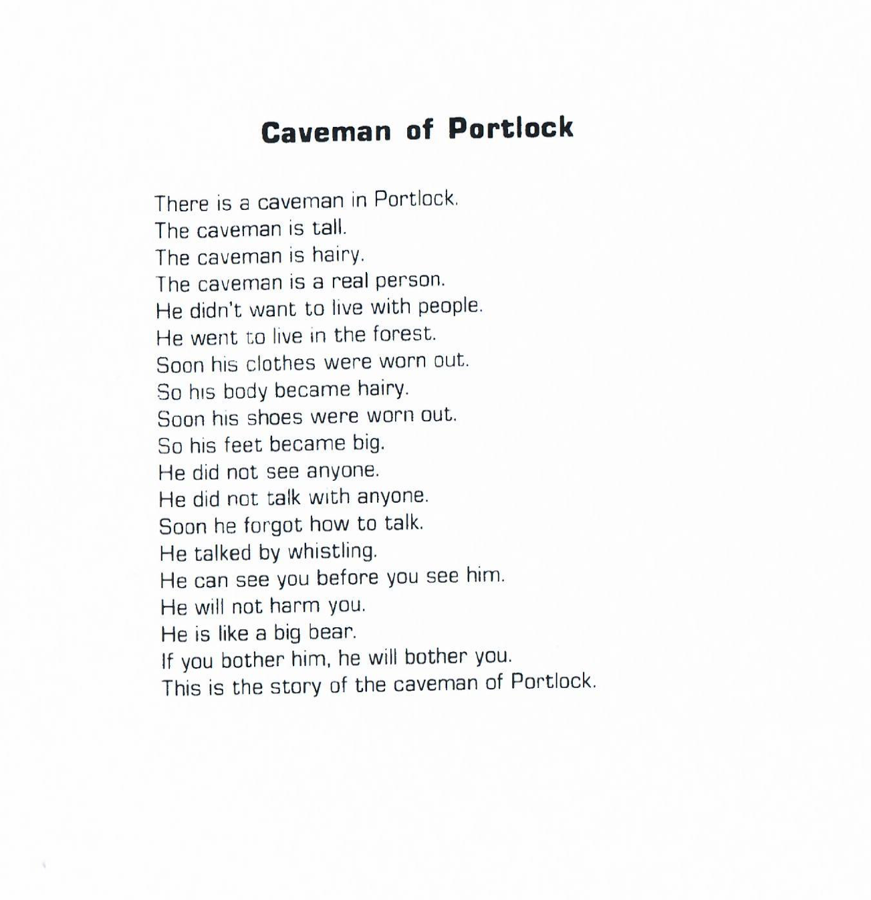
Old Beliefs English translation

Slide 14
Questions and Comments
Please share your knowledge to help build the Heritage kit, Thank you.

Slide 15
Interview Questions
Hello and welcome. I am ____________________, a Local Education Coordinator with the Chugachmiut Heritage Program. Today is ___ , 2018. and we’ve invited __________________ to contribute to the cache of Elder interviews we’re collecting for the Heritage Kit “Traditional Place Names.”
Could you please introduce yourself.
I’m _________________________ and I was born in 19__ In _____________________. My father was _______________________ and my mother was _________________________.
Traditional place names reflect the history and importance of particular locations. Place names serve as a representation of the history of an area, a focus of culture and knowledge which was/is important for the maintenance of the physical and spiritual identity of a people. When a name is forgotten, more than a name is lost.

Slide 16
More questions…
Do you know of any traditional stories, songs, about place names?
What was the primary method to pass on the knowledge from one generation to the next generation, in societies that did not rely on written language?
Can you give any information of an area with traditional place names known within the area in which you live?
Can you share information on any traditional place names areas used in the past that might not otherwise be known?
What historic events happened that made this village a memorable place?
Place names often convey diverse information on a variety of traditional features of a people; do you know of the traditional lifestyle of those people that inhabited these villages before these villages became abandoned?

Slide 17
And more…
7. How does the past lifestyle compare to how the lifestyle we live now?
8. Please share some information especially important about an area where historical records are sparse or populations were decimated by disease and/or displaced through forced relocation? (examples)
9. What information do you know of that can explain the occupation of the land and the delineation of people in that area and their territory?
10. What were the names used to describe places that give clues to the identity of previous inhabitants; population centers, trail systems, transportation routes?

Slide 18
Almost done…
11. What are the meanings behind these names? Did they provide a glimpse of the ancient relationships with the land and the personal life experiences that perhaps have set one location off from another?
12. Are there any fragments of history that can be reconstructed by studying traditional place names? please explain
13. Did the people from these traditional places have or share a territory with members of other tribal groups? If so, how?
14. Traditional place names refer to abandoned villages, land marks, trails between villages. When you hear “traditional place names” what is the first thought that comes to your mind?

Slide 19
Hang in there…
15. Can you name some of the abandoned traditional villages around your community?
16. Do you know the Sugt’stun/Eyak names of these places?
17. Do you know any stories from these abandoned places? such as why were they abandoned? and where did the people move to from these villages?
18. Have you ever visited any of the abandoned villages? What did you see and what did you experience?

Slide 20
Yahoo… the last ones.
19. What historic event happened that made the village a memorable place?
20. Can you share some information on the history of the community that you live in? What year was it established? Who were the main people who helped build the community? What is the population? What are some places that are an important part of the community?

